Slide 1

Welcome To Metrolec
Website: http://www.metrolec.net.au/
Address: Gawler, Adelaide, South Australia 5118
Phone: 1300 775 487

Slide 2
Air-Conditioners
We can install a variety of systems to suit your needs depending on space and budget. We work with the very best brands in the industry including:
  Daikin
  Fujitsu
  Panasonic
  Mitsubishi
Most of the Domestic Air Conditioning systems we install are split and multi split systems but we also install fully ducted systems as well.
Website: http://www.metrolec.net.au/
Phone: 1300 775 487

Slide 3
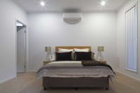
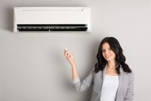
Reverse Cycle Air Conditioning
Split System Air Conditioning
Looking for a new air conditioning system for your home, office or business? At Metrolec Air Conditioning we can help you with the very best advice, service and installation of Reverse Cycle Air Conditioning. Reverse Cycle Air Conditioning comes in a number of different systems which include Portable, Split, Mulit Split and Ducted
We’re proud to work with the best brands in the industry and specialize in the installation and service of Split System Air Conditioning. There are a fantastic variety of makes and models of split systems, each of them offering something to suit different requirements. With advances in technology, split systems are now extremely quiet, efficient and clean.
Website: http://www.metrolec.net.au/
Phone: 1300 775 487

Slide 4
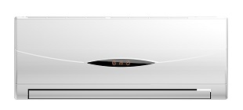
Domestic Ducted Air Conditioning
At Metrolec our fully licensed electricians have over 10 years’ experience in the installation of air conditioners in family homes. A large part of our business is domestic so we understand the best systems available for various domestic requirements. We have a full range of quality Ducted Air Conditioning systems for the domestic market.
Website: http://www.metrolec.net.au/
Phone: 1300 775 487

Slide 5
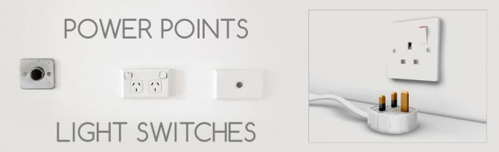
Domestic Electrical Power Points and Light Switches
Power Points and Light Switches come in all shapes, sizes and designs and should always be installed by a fully qualified and licensed electrician. We can have one of our electricians at your home within 24 hours for non-emergency jobs and have everything installed with a minimum of disruption and at a very affordable price.
Website: http://www.metrolec.net.au/
Phone: 1300 775 487

Slide 6
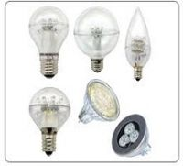
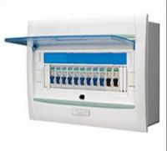
LED Lighting
Safety Switch
LED Lighting is extremely energy efficient, which means savings on your electricity bill. Metrolec have over 20 years’ experience in the electrical trades industry and are the go to people for LED Lighting in Adelaide.
One of the best forms of protection for your property is a reliable and top quality Domestic Electrical Safety Switch. At Metrolec, our fully licensed and qualified electricians are proud to work with Clipsal Safety Switches.
Website: http://www.metrolec.net.au/
Phone: 1300 775 487

Slide 7
Switchboards
Safety switches are a crucial component for any switchboard, and for good reason. They are expected to activate the second they are needed, when your mechanical device fails, the safety switch will ensure that the board and anything else is protected. However, they require regular testing, usually a few months at a time. Although we recommend hiring an electrician, there are a few tests you can perform to identify any problems your safety switches may be having, or if it needs to be repaired by an electrician.
It is important to understand the safety concerns of switchboards, and what you need to watch for. Before you can contact an electrician, it is important to return the switch back to its original position. If it was ON, then pressing it again will bring it back to this state. However, in some rare cases, the switch may still be operating but may not be functioned correctly, it is important to hire a professional electrician Gawler that can safely test and repair any problems.
Website: http://www.metrolec.net.au/
Phone: 1300 775 487

Slide 8
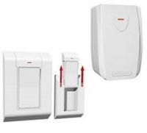
Switchboards
Website: http://www.metrolec.net.au/
Phone: 1300 775 487

Slide 9
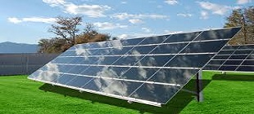
Solar
Reducing energy bills and taking care of the environment by lowering carbon emissions should be high on any households list and at Metrolec we can help you do exactly that. We can give you the best advice, sales, installation and service on top quality Solar Power Systems for your home electricity needs.
Website: http://www.metrolec.net.au/
Phone: 1300 775 487

Slide 10
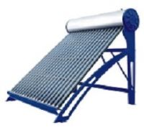
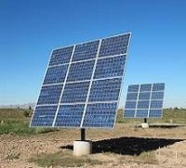
Solar - Brand Suntrix
Solar - Brand Tindo
When we install a SunTrix in your home we know you’re going to get the very best in quality and performance. Locally manufactured, SunTrix have produced 1000s of Solar systems for South Australians and the benefits have been great.
Tindo Solar Panels are Australian made for Australia and the rest of the world. They use advanced technology to produce Tindo Solar Systems that harness the natural energy of the sun efficiently and are made to last.
Website: http://www.metrolec.net.au/
Phone: 1300 775 487

Slide 11
Thank You
Metrolec
Website: http://www.metrolec.net.au/
Phone: 1300 775 487
Address: Gawler, Adelaide, South Australia 5118

