Slide 1
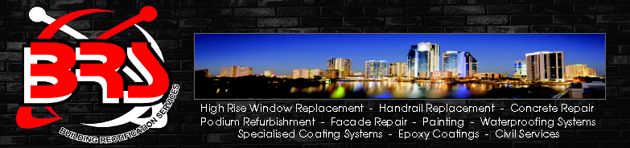
Work at Heights Safety Management System

Slide 2
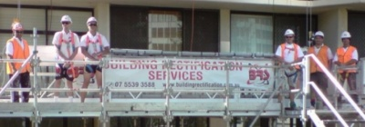
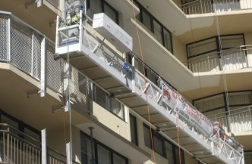
Policy and Philosophy
Building Rectification Services commitment, and on going investment into Workplace Health and Safety has identified many work at heights issues. In particular Swing Stage Operations and Management.
Our Philosophy of POSITIVE SAFETY behaviour is central to all, Building Rectification Services projects. When Safety Regulations for Work at Heights and swing stage works. We seriously understand that there must be a ZERO HARM team mindset.
This has been achieved
Exceeding regulatory specifications by always having a back up or secondary system.
Employment of Independent Risk Assessors
Employment of Independent Structural Engineers
Working closely with regulatory authorities, including WHSQ
In-house Training
Recognised Certification and Training
Application of dot point style checklists, including a comprehensive Site Folder
Site Auditing, including spot audits by Independent Risk Assessors and Queensland Workplace Health and Safety Inspectors

Slide 3
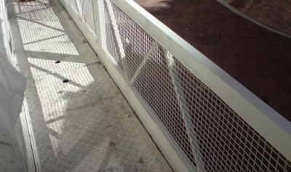
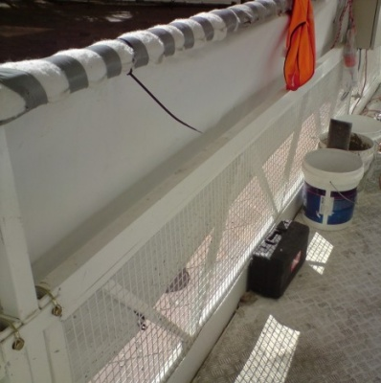
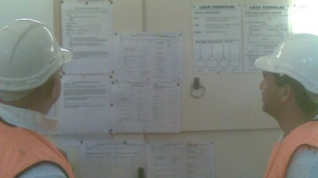
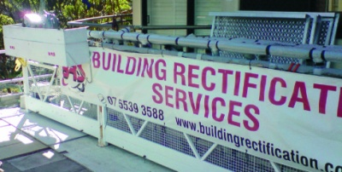
Hazard Identification &
Risk Management Control Process
Planning and Management is always the result of:
- Professional Advice
- Management Experience
- Employee concerns and requirements
SWING STAGE CRADLE Built in Weldmesh Panels, for cradle containment of tools and / or equipment
To keep tools and small equipment off th floor to reduce tripping hazards and / or accidental knocking of objects off the swing stage
HighBack Light Weight Toolboxes To keep tools and small equipment off the floor to reduce tripping hazards and / or accidental knocking of objects off the swing stage

Slide 4
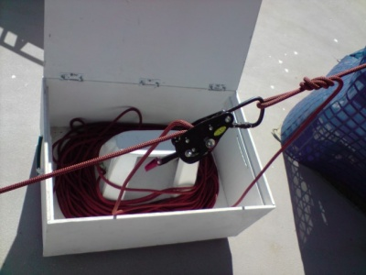
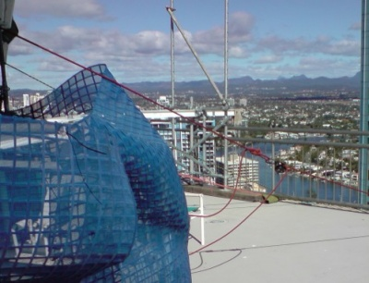
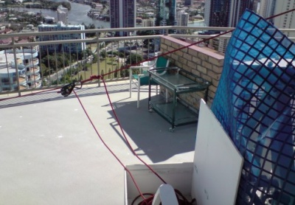
Safety Lines Our safety lines are attached to the building, via certified attachment points. Not only is this safety line a secondary line of safety; it is also a rescue line. This is achieved by way of a rescue stop, and enough extra safety line on the roof (or area above the swing stage); to lower a stranded
person to a safe area below, or to the ground
Employment of Independent of Risk Assessors
Although we have had our own safety and management plans, independent advisors give new angles and approach to simplified but comprehensive management plans. For example, Risk Management International.
Employment of Independent Structural Engineers.
New Designs, innovations and Engineering in Swing Stage Suspension Systems. Design includes Quick Assemble Suspension Beams.
This can be adapted for various size beams and out boards. Features include:
- Adjustable and Swivel Support Legs
- Bolt on Cournter Weight Boxes
- Simple bolt together design that is extremely strong, with few components
Employment of companies such as Stephen Waite Structural Engineers has been a great help in innovations for the more difficult access jobs.

Slide 5
Site Audits
Spot audits are carried out by Independent Professionals Safety Auditors, In-house Site Supervisors and Independent Engineers. e.g.
- Risk Management International
- Build check and Weekly Site Minutes
- Stephen Waite Engineers
Projects Health and Safety Structure Systems and Procedures
To make our management system clear, yet comprehensive, a simple dot point checklist is available for, each and every task.
This laid out simply in our "Site Folder Index".
currently 1 Senior Manager certified.

Slide 6
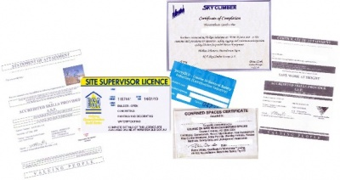
Training is part of this Site Folder and Checklist, with two main areas of training.
In-house training
- Safety Line Induction and Rescue procedures to Australian Standarde 1891
- Swing Stage Operators Certificate of Induction. Instructed by licensed and experienced Advanced Scaffolders
- Daily, Weekly and Monthly Checklists
- Daily pre-start and toolbox meetings
- Monthly general toolbox meetings to include guest speakers in the fields of works safety and training
Recognised Certification and Training
Out of a total of approximately 40 staff
- All workers Blue Card (construction induction) certified
- All workers Work at Heights certified
- 'Basic Scaffold' currenlty 10 certified staff
- 'Intermediate Scaffold' currently 6 certified staff
- 'Advanced Scaffold' currently 3 certified staff
- 'Dogger' currently 6 certified staff
- 'Confined Spaces' currently 8 certified staff
- 'Electrical Testers' currently 2 certified staff
- 'Elevated Work Platform' currently 6 certified staff
- Military Certification in Rope Access Safety, Search and Recovery, currently
1 Senior Manager certified
- Certification in the Procedures for Operation, Safety, Rigging and
Maintenance Inspection of Sky Climber Suspended Access Equipment,
currently 1 Senior Manager certified.

Slide 7
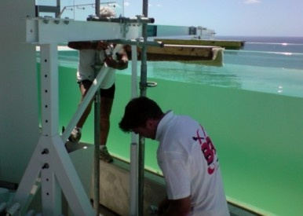
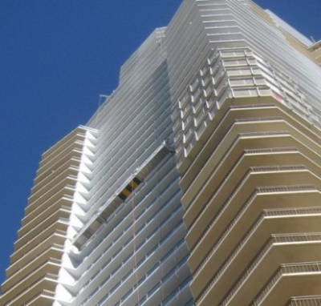
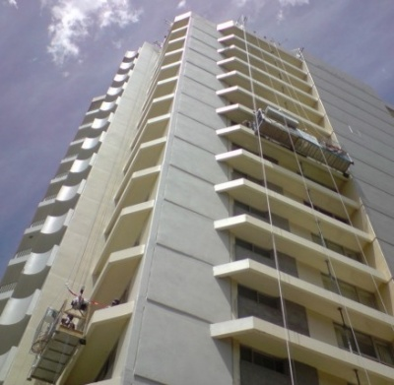
Summary
It is a credit to our employees and contractors that we have come this far. Through efforts, innovations and ideas generated for our projects, we have achieved continuous improvements.
Building Rectification Services is pleased with this progress, we also know we need to continue to do more.
Building Rectification Services recognises the company is only as good as its employees. A major investment has been allocated for ongoing training at all levels of Management through to all workers.
Through ongoing training and a simple but comprehensive management program, we have made the workplace safer for everyone.

