Slide 1
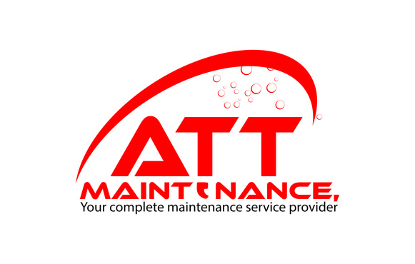

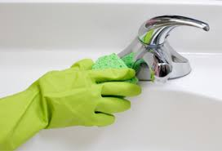
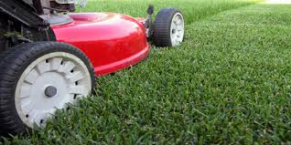
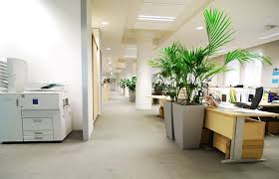

Slide 2

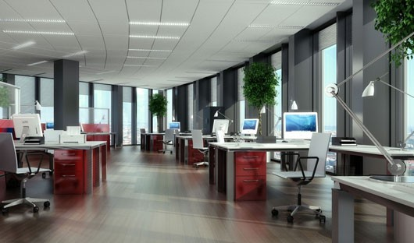
About ATT
ATT IS A PROFESSIONAL COMMERCIAL AND INDUSTRIAL CLEANING COMPANY.
OUR SUCCESS IS ATTRIBUTED TO OUR TIMELESS CUSTOMER-FOCUSED PHILOSOPHY AND PROFESSIONAL SERVICE.
We offer a range of cleaning services;
  Hospitals / Medical Centres
  Commercial and Industrial
  Education
  Retail
  Real Estate
  Event Management
  Grounds maintenance

Slide 3
About ATT
A professional, commercial and industrial cleaning company
A reliable, co-operative and cost efficient service
More than 8 years experience in the industry
Modern cleaning systems (machinery, products and tools)

Slide 4
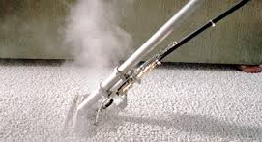
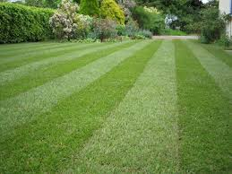


Our Range of Services
Carpet steam cleaning
Window wash & squeegee
All types of hard floor strip and sealing
Waste removal
Wall and ceiling
Provision of toilet requisites
High pressure cleaning
Pest control
Painting
Mowing, slashing, and brush cutting
Garden maintenance and landscaping,
Weed control and herbicide spraying
Gutter and down pipe cleaning
Tree lopping and chain saw works, wooden
floor sanding & polishing
Plumbing services, handy man services

Slide 5
Economical Cleaning Package Plans
We are heavily focused on meeting the needs of our clients so if you need a tailored package we can accommodate even in the economical package. Our passion for quality has not been sacrificed keeping ATT’s standard for excellence at a high with industry leading prices.
Basic Service Package
Dusting, Vacuuming, Mopping, Waste Removal, Damp wipe
Extensive Service Package
Wall & Ceiling, Window Wash & Squeegee, Garden maintenance and Landscaping, Carpet steam cleaning
Preventative Maintenance Care Package
Pest control, Floor Strip & Ceiling, High pressure cleaning, Painting

Slide 6

Customer satisfaction guarantee
For a peace of mind there is 100% money back guarantee for any job that has not your standards or the standards we uphold for our company. (terms and conditions may apply)
ATT staff’s photos

Slide 7
Wholesale consumable pricing
Thanks to our strong purchasing power with suppliers, we offer all the cleaning products you need
at wholesale prices.
PRODUCTS | PRODUCT CODE | BOX/QUANTITY | SUPPLY COST (GST Excluded)
Toilet rolls Livi Premium | Livi 1001 | 1 box / 48 rolls | $25.00
Toilet Jumbo rolls Livi (1 ply) | LIVI 1100 | 1 box / 8 rolls | $28.00
Toilet Jumbo rolls Livi (2 ply) | LIVI 2200 | 1 box / 8 rolls | $27.00
Multifold hand paper towels - Higher Quality | Veora 2400 pieces | 1 box | $32.00
Multifold hand paper towels | Livia 3000 pieces | 1 box | $39.50
Garbage bags | 72 Ltr | 250 pieces | $21.00
Garbage bags(Heavy duty) | 72 Ltr | 200 pieces | $32.00
Bin Liner1 | 27 Ltr | 1,000 pieces | $19.50
Liquid Hand Soap 1 | Pink Pearl | 5L | $14.00
Liquid Hand Soap 1 | Pink Pearl | 25L | $45.00
Liquid Hand Soap 2 | Anti Bacteria | 5L | $16.00
Liquid Hand Soap 3 | Anti Bacteria | 25L | $58.00
Air Freshener Unit (Auto) | AF106 | 1 unit | From $20.00
Fragrance Can | B208 300ml, 3200 sprays | 1 unit | $8.50
Sanitary Bin Services | Replacement Service | 1 unit service | $6.00
(Conditions apply: limited to cleaning service account holders ONLY with ATT Maintenance)

Slide 8

The benefits of choosing us as your provider
ATT’s Beneficial Services (*Terms and Conditions may apply)
Germ Test for office appliances (ATP TESTING)
Complimentary Electric Safety Tags for all cleaning electric equipment.
Cleaning Equipment Checks / Supply
We supply the latest upgraded brand new cleaning equipment and hospital grade disinfectants, enabling. ATT to provide a higher
quality cleaning and maintenance service. (e.g. colour coded product spray bottles, mops etc)
In/Ex window cleaning services (Permit to use water from Sydney Water: WRE082218)
We can provide discounted or complimentary window washing service
Carpet steam cleaning service – Helps eliminate allergens and odors, which may cause hay fever
and other reactions(Register No. 96908)
We can provide discounted or complimentary carpet cleaning service
Initial, spring cleaning and high dustings.
Free $1,000.00 Voucher

Slide 9
On-site Supervisor
Day to day staff and quality control
Material usage and distribution of facility requirements
Operations Manager
General Manager
Determines the overall outcome
Available anytime upon clients request
Transparent company structure
Staffing, equipment,
liaising with client
representatives, quality
control and periodic
duties

Slide 10

ATT’s Quality Management Control
ATT’s Quality Management Control System is designed to meet your objectives.
Our customized QMC delivers work scheduling, client communication, inspection updates and work reviews on service delivery standards.
Schedule
Check lists
Communication book
Q.C Manager inspection
Audit reports

Slide 11
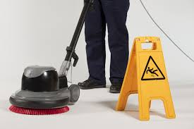


Communication and Training
Our high service quality is maintained through ongoing training and strong communication between you, our employees and management.
A communication book is provided for all parties to raise any issues or queries
All ATT employees receive proper training and education on WHS standards prior to working onsite
Regular fortnightly visits by our Operations Manager to ensure high standards of service are being maintained
Jack Kwong – General Manager conducts visits periodically or upon request to maintain client relationships and review cleaning performance.

Slide 12

Systematic Management
Quality Control system
Quality Assurance System
ATT Maintenance has assembled a team of highly skilled and competent management, administration, and operational personnel. We pride ourselves on the ability to meet, or, exceed customer requirements, whilst maintaining the highest possible standards of occupational health and safety and environmental
awareness in the workplace.
Site inspection / WHS System
Public Liability and Workers Compensation Insurance coverage

Slide 13

ATT is A GREEN COMPANY
Safe disposing of chemicals
Purchasing biodegradable products
Reducing excessive consumption
Recycling
Environmental conservation efforts

Slide 14
















ATT Variety of Clientele
Hospitals /
Medical centres
Office / Warehouse and Industrial / Commercial real estate
Automotive Dealership
Cinemas and Theatre
Clubs
Food manufacturing
plants
Church &
Religious sector
Retails
Aged care /
Child care centre

Slide 15


Thank you for your valuable time
CALL US TODAY
for a free inspection and quotation
For further information please contact us
1300 009 994
Email : marketing@attgroup.com.au

