Slide 1
Case Study _ Smart Art
Team Type: Cross Functional Team Size: 6 members
Project Meetings: 12
Primary Metric: Specific customer complaint on average every 19 days causes $75k in rework annually
Root Causes: Communication, Process Flow, Records management
Outcomes:
Analyse production conflicting communication channels
Process map and modify work instruction flow
Creation of ‘Specification Folders’
Purchase of filing equipment
Ownership & accountability
Production staff awareness training
Overall Benefit:
90% reduction in customer complaints / rework; $67,500 saved

Slide 2
Case Study _ Screw Loose
Team Type: Cross Functional Team Size: 10 members
Project Meetings: 12 / 5mths
Primary Metric:
Machine Set Up team spent 8% of ‘setting’ time searching for parts.
Project Focus: Spare / consumable parts inventory control
Root Cause: No sustainable and organised system in place
Outcomes:
Critical parts identification
Min / Max stock levels set
Portable parts trolley for consumable spares
Reorder cards generated
Awareness training for Set Up team
Responsibilities allocated
Audit process implemented
Overall Benefit: $50,000 production opportunity minus $1,000 in materials and in-house implementation labour

Slide 3
Case Study _ The Innovators
Team Type: Area based Team Size: 12 (across shifts)
Project Meetings: 8
Primary Metric: Screen damages were costing $8,000 /week
Project Focus: Reduce damages by 75%
Root Causes: Machine settings, calibration, training, repair technique
Outcomes:
Blade angle trials and solution standardisation
Operator training
Manufacture calibration tool
Modify repair technique
Overall Benefit: $300,000 saved in reducing production stoppages and replacement materials purchase.

Slide 4
Case Study _ Outside the Box
Team Type: Cross Functional Team Size: 10 members
Project Meetings: 6
Primary Metric: Bottling Line efficiency at 35%.
Root Causes: Manning allocation to large batch packaging.
Project Focus: Improve Overall Equipment Efficiency and produce to target.
Outcomes:
Study of out-feed bottlenecks
Two shift approach
Shift One: Supplementary labour for trial, increase headcount x 1
Shift Two: Shift 2IC manages supply chain to the line
Overall Benefit:
Trial shifts averaged 113% OEE (2% difference between shifts)
Overall task averaged 84% OEE, inclusive of product changeover
63% increase in production rates during the trial ($110k bonus)
Task completed with 72 man-hours of original planned labour to spare

Slide 5
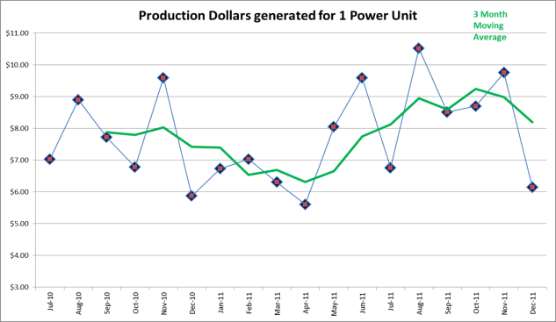
Case Study _ Supa Green
Team Type: Cross Functional Team Size: 6 members
Project Meetings: 11
Primary Metric:
Production income generated per Power Unit consumed
Root Causes: Lighting design, machine operation and maintenance
Project Focus: To increase income to power usage ratio
Outcomes:
Lighting survey
Install energy efficient lighting to the factory
Repair sources of energy loss
Installation of timers
Staff awareness campaign
Benefit / first six months, post solution implementation:
21% power efficiency; $19k savings.
$700k production without power costs attached
Increased benefit with Carbon Tax implementation

Slide 6
Case Study _ Logistic Nightmares
Team Type: Area based Team Size: 7 members
Project Meetings: 9
Primary Metric: 14% complaint to Inventory Control process
Root Causes: Time, accountability, process deficiencies
Project Focus: Implement system to attain <90% compliance
Outcomes:
Clarify and standardise Inventory Control process
Schedule cyclic counts
Set accountabilities and KPI’s
Train logistics staff
Overall Benefit:
Compliance to Legislative Authority targets
100% compliant to target with warehousing operations
Solutions were able to be replicated in another area

