Slide 1

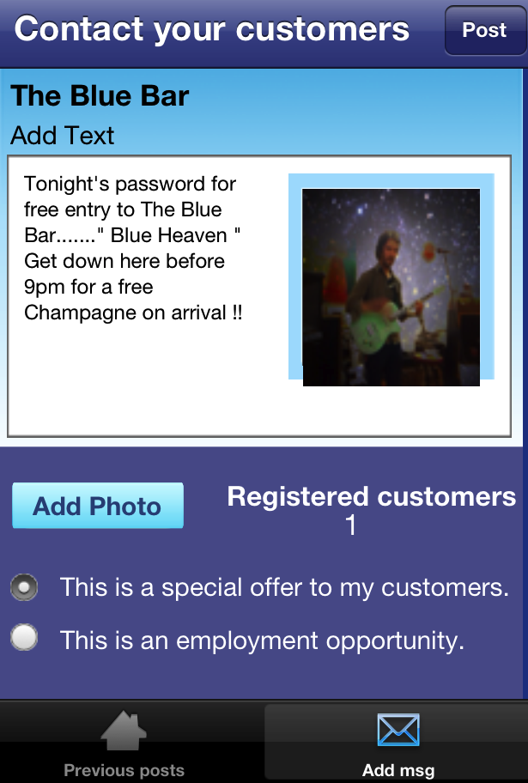
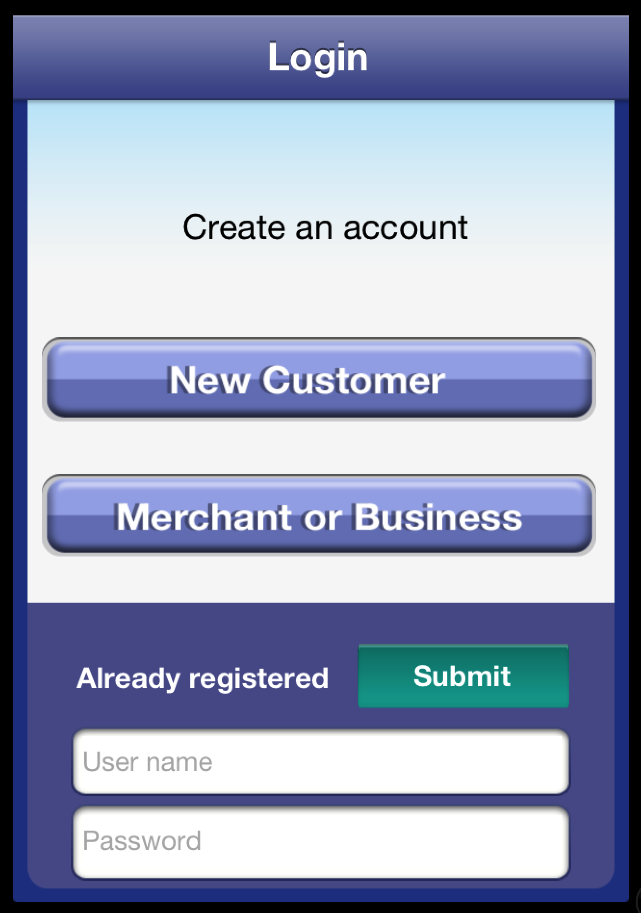
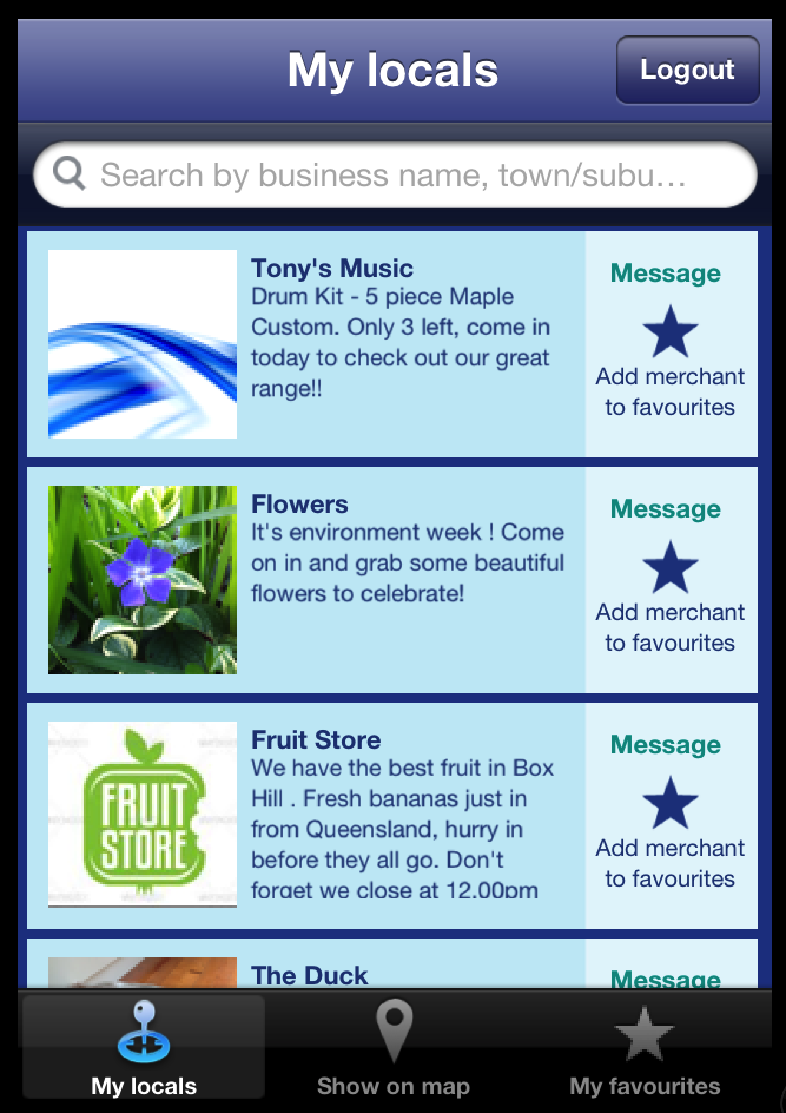

Merchant or Business use
Merchants post their deals & offers to server
Merchant’s posts appear on customers device
Customer use
App conducts a 5km radius search of customers location

