Slide 1

White Shine Cleaning
A Company of Professional Home Cleaners in Melbourne
http://melbournecleaningexpert.com.au/

Slide 2
Introduction
The White Shine Cleaning is a home and end of lease cleaning services provider company in Melbourne, Australia. Our cleaners offer both commercial and residential cleaning services in the entire Melbourne area. We are also known for the best window, carpet, duct, tile, mattress and curtain cleaning.
In this PowerPoint, we are showing some of our services in the form of images.

Slide 3

House Cleaning Services

Slide 4

End of Lease Cleaning Services
Visit for more details: - http://melbournecleaningexpert.com.au/end-of-lease.php

Slide 5
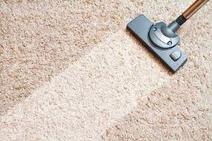
Carpet & Rug Cleaning Services
Visit for more details: - http://melbournecleaningexpert.com.au/carpet-rug.php

Slide 6
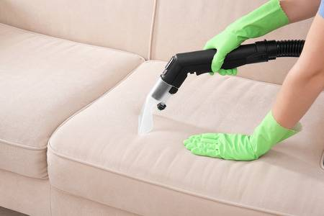
Upholstery Cleaning Services
Visit for more details: - http://melbournecleaningexpert.com.au/upholstery.php

Slide 7
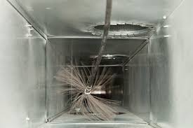
Duct Cleaning Services
Visit for more details: - http://melbournecleaningexpert.com.au/duct.php

Slide 8
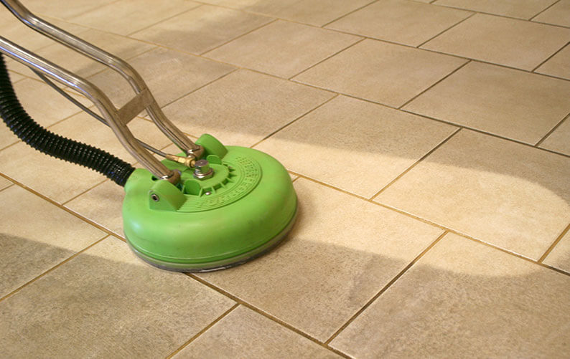
Tile & Grout Cleaning Services
Visit for more details: - http://melbournecleaningexpert.com.au/tile-grout.php

Slide 9
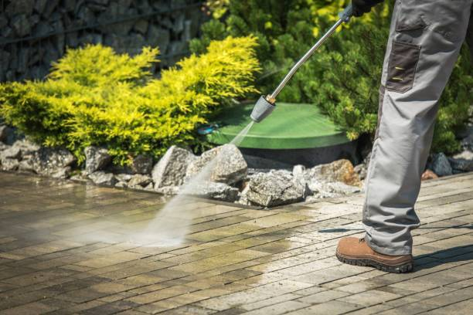
Pressure Cleaning Services
Visit for more details: - http://melbournecleaningexpert.com.au/pressure.php

Slide 10
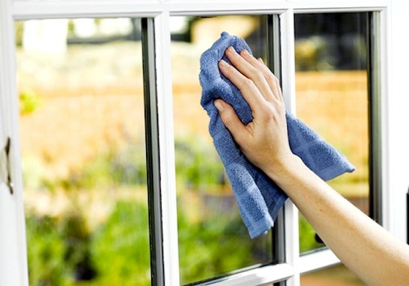
Window Cleaning Services
Visit for more details: - http://melbournecleaningexpert.com.au/window.php

Slide 11
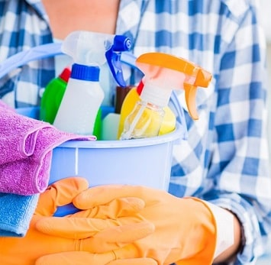
Regular Cleaning Services
Visit for more details: - http://melbournecleaningexpert.com.au/regular.php

Slide 12
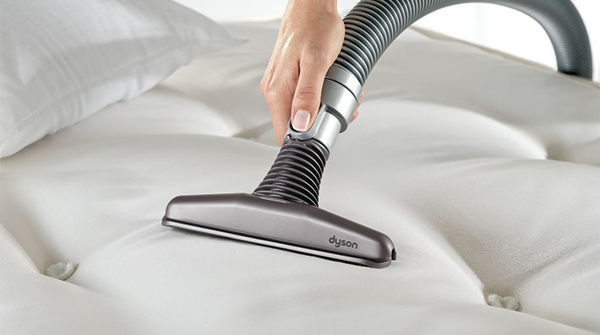
Mattress Cleaning Services
Visit for more details: - http://melbournecleaningexpert.com.au/mattress.php

Slide 13
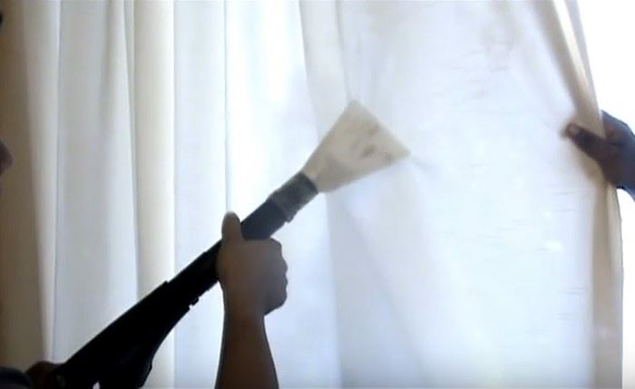
Curtains/Blinds Cleaning Services
Visit for more details: - http://melbournecleaningexpert.com.au/curtains-blinds.php

Slide 14
Thank You

