Slide 1


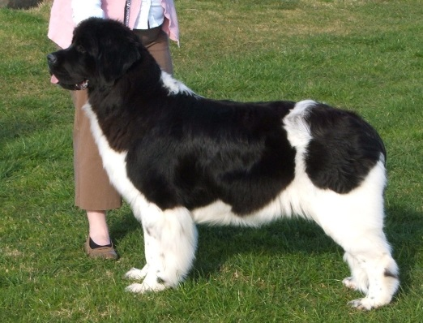
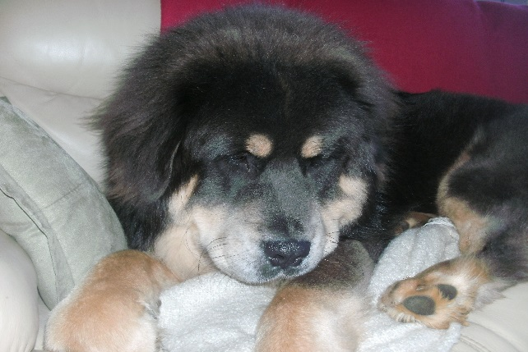
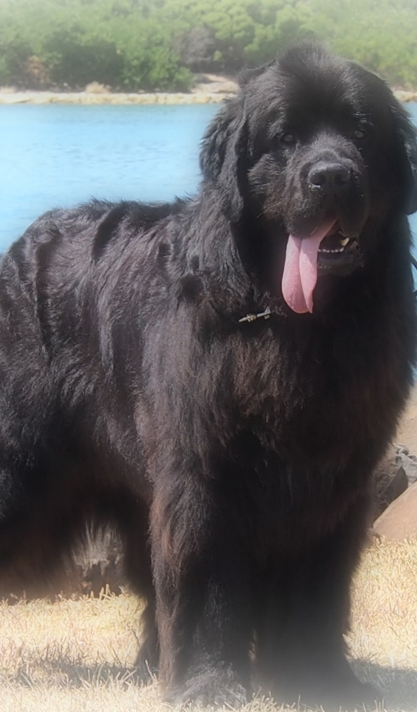
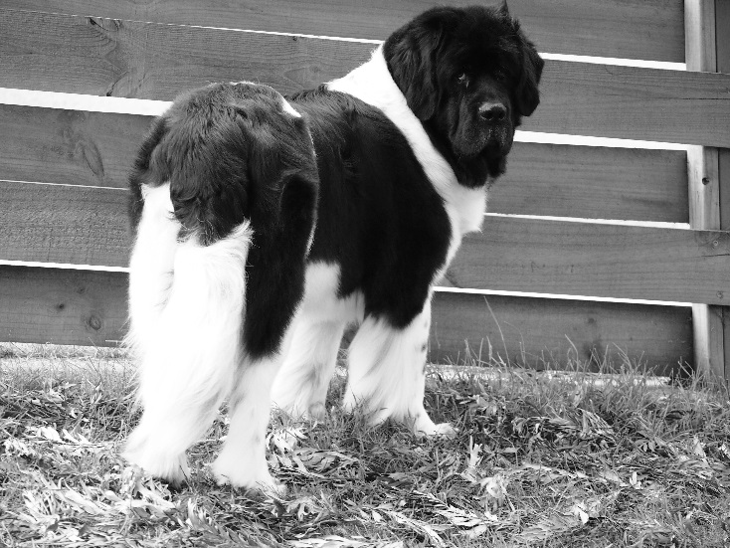

SOAKED TO THE BONE
DOG GROOMING
CONTACT DETAILS
Shannah Joseph &
Damian Targett
Phone: 0407845094
Or find us on facebook at SOAKED TO THE BONE
ABN 23115752875

Slide 2



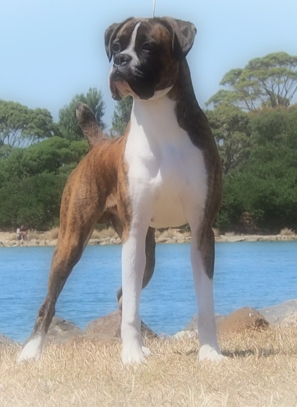

PRICE LIST
We are a small home-based business located in Burnie. All dogs that visit our home are treated with the upmost care and respect. We are members of Dogs Tasmania and Burnie & District Kennel club. We never groom any more than 2 or 3 dogs a day as we like all our pooches to have lots of love, attention and care.
SIZE | Bath, Dry & Groom Dog to have no matts | Clip, Bath, Dry & Groom
Small Breeds Maltese, Shih tzu Toy Poodle etc. | $30 | $50
Opening Hours:
Please book for appointments
Mon – 9am – 4pm
Tue – 9am – 4pm
Wed – 9am – 4pm
Thur – 9am – 4pm
Appointments available occasionally on Friday and weekends.
Medium Breeds Spaniels, Mini Poodles etc.
$50
$70
$70
$90
Large Breeds Labrador, Golden Ret, Husky’s, Boxers etc.
Giant Breeds Alaskan Malamute, Newfoundland, St Bernard, Bernese etc.
$100
$120

