Slide 1

POS CENTRAL
Point of sales Supplier in Australia

Slide 2
ABOUT POS CENTRAL
POS Central is the one stop solution for items such as POS software, POS hardware as well as other POS supplies. The company is known for offering the best quality POS equipment from the most reputed manufacturers and suppliers of the POS systems.
Some of the common equipment that are available with POS Central include cash drawers, receipt printers, label printers, barcode scanners, cash registers, portable data terminals, customer information system, mobile computers and a lot more other such devices that are required for the POS system.

Slide 3
OUR POLICY
POS Central offers the best services to the clients by not only providing the right kind of equipment that is required by any particular client but also by understanding the basic requirement of the client.
The professional team that is available at POS Central are highly experienced and are always eager to help the clients to choose the perfect equipment that is most suitable. The company is also known for providing customised solutions to businesses like electrical and hardware stores, independent and chain retailers, speciality stores, convenient stores and many other different business units.

Slide 4
CASH DRAWERS
Cash drawer is another important component of the Point of sale system. It is basically a drawer with different sections to safely keep the coins in separate section and money of different denominations in different sections. It is normally driven by a printer or a terminal. It also has a section for keeping the cards safely.
The standard cash drawer that is available with POS central is having a solid steel construction with eight slots for coin and five slots for notes. It is equipped with a standard receipt printer connector.

Slide 5
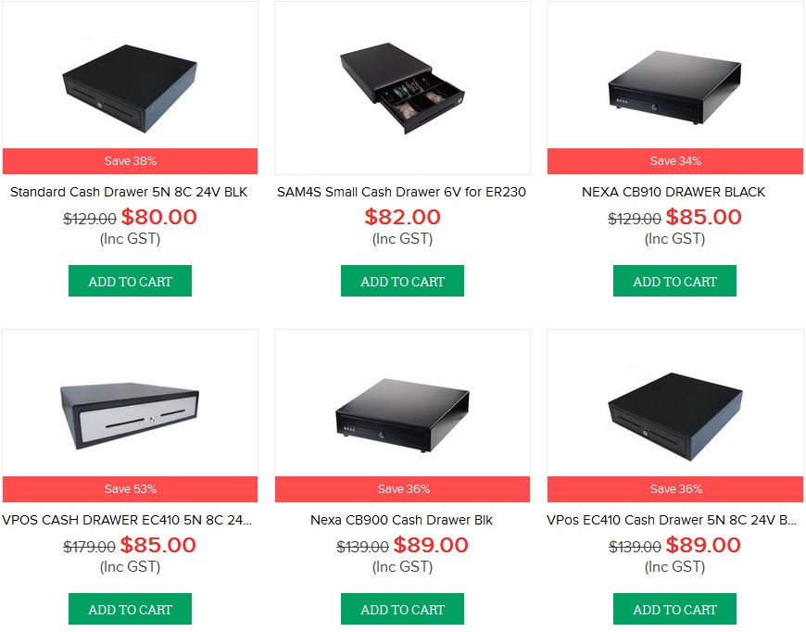
POS CENTRAL OFFERS DIFFERENT VARIETIES OF CASH DRAWERS OF TOP BRANDS WITH SPECIAL PRICE

Slide 6
RECEIPT PRINTERS
Receipt printers are one of the most essential items in the point of sale system. It is used for generating the receipt after the payment has been initiated with the help of the cards that are mostly used by the people for transaction these days. It also helps in generating the customer receipt. Such kind of printers is mostly used in the cash counter of the restaurants, shopping malls, multiplexes. The printer is connected with the computer that is used for calculating the total amount that has been purchased by any customer with the help of interface.

Slide 7
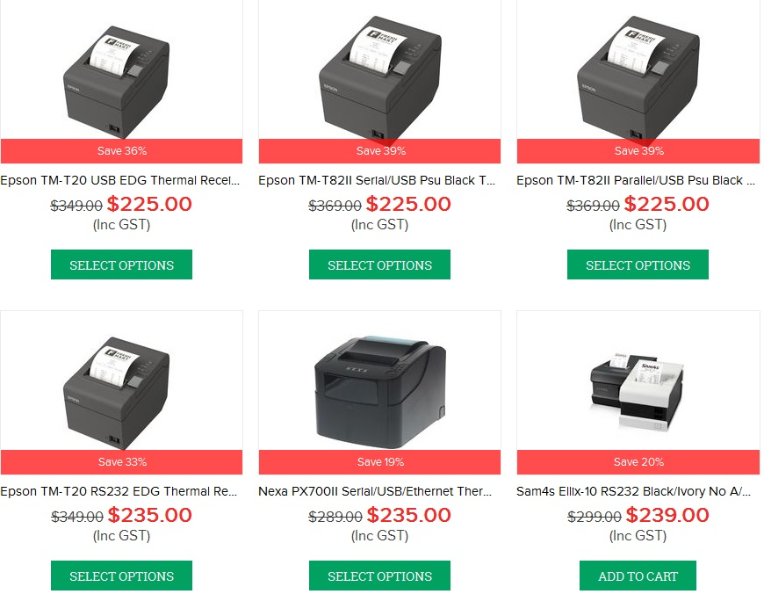
POS CENTRAL OFFERS SPECIAL TYPES OF RECEIPT PRINTERS FROM TOP BRANDS

Slide 8
BARCODE SCANNERS
  An electronic device that is capable of reading the printed barcodes and output it to a computer is known as Barcode scanners. It is an integral part of the point of sale as it helps in increasing the speed of checkout. It is equipped with a light source, a light sensor that translates the optical impulses into electrical impulse and a lens.
  POS central offers the most durable and reliable barcode scanner at the most affordable price range. The handheld scanner that is available with POS Central offers accurate result and also ensures long lasting performance.

Slide 9
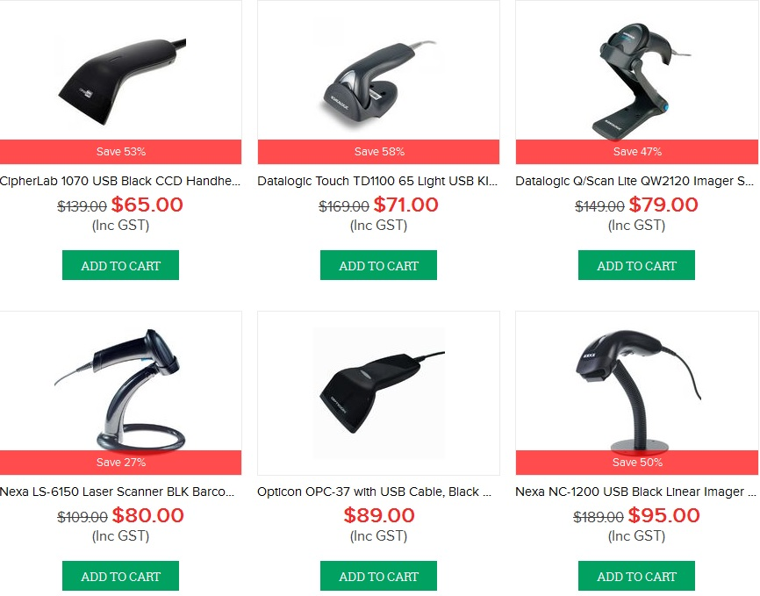
SOME OF THE FAMOUS BARCODE SCANNERS OFFERED BY TOP BRANDS

Slide 10
LABEL PRINTERS
Label printers are capable of printing customised labels. The label printer available with POS central is normally battery operated and is capable of print wirelessly from any compatible mobile device.
POS Central is Australia’s leading provider of Label Printers. Get professional Label Printing Solutions with local support and fast Australia wide shipping!

Slide 11
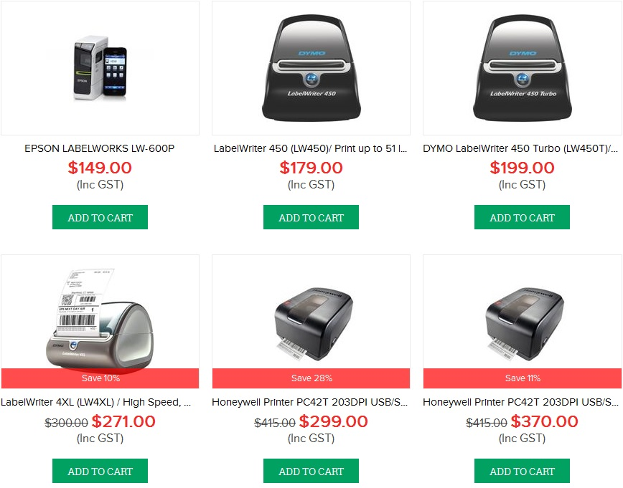
POS CENTRAL OFFERS LABEL PRINTERS OF FAMOUS BRANDS @ AFFORDABLE PRICES

Slide 12
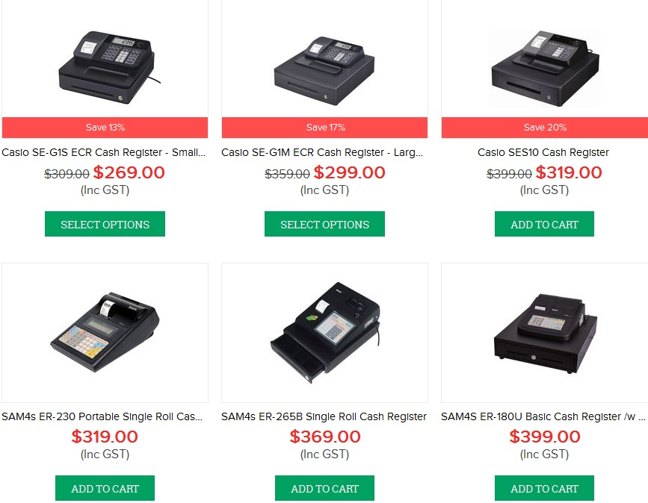
CASH REGISTERS ARE USED FOR SHOWING THE DISPLAY OF SALES ON THE LCD SCREEN.

Slide 13
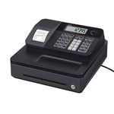
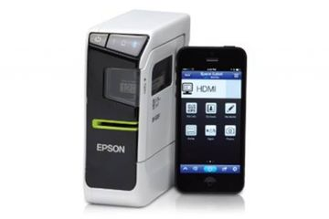
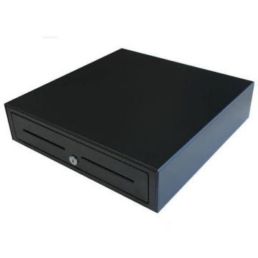
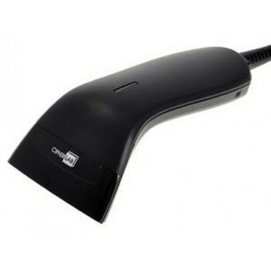
Thank You
For more information : Visit us @ https://www.poscentral.com.au/
For any query, Call us @ 1300590094

