Slide 1

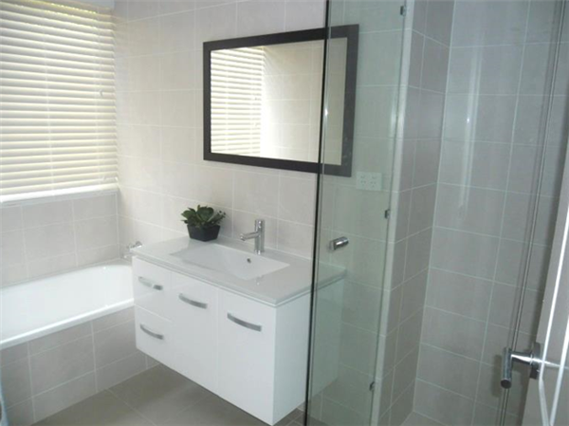
Welcome to Hotspace Consultants
Renovating made easy

Slide 2

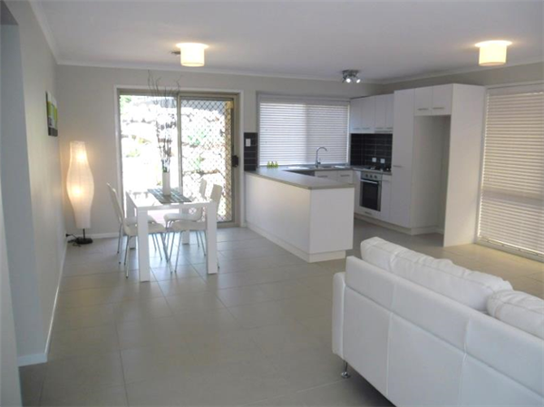
About Us
Our Services
Why Hotspace?
Contact Us

Slide 3

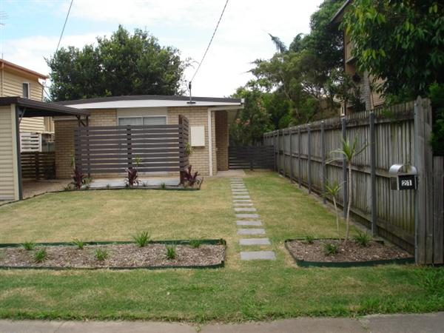
When it comes to home renovation in Melbourne, Hotspace is the most trusted name. Our team of experts will give a whole new look to your living space and your house will be a much better place to live in.

Slide 4

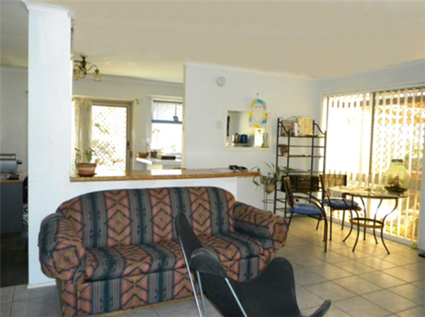
We specialise in home renovation and our quality of service will speak for ourselves. We take on both domestic and commercial work and we can guarantee that you will simply love our work.

Slide 5
Why Hotspace?
Our previous customers have very high regards for the quality of service we offer them. We are sure that our team will be able to maintain that same quality for you as well. And, most importantly, the price at which we provide our service is unbeatable.

Slide 6


Call us on 1300 90 88 90
Or visit www.hotspaceconsultants.com

