Slide 1
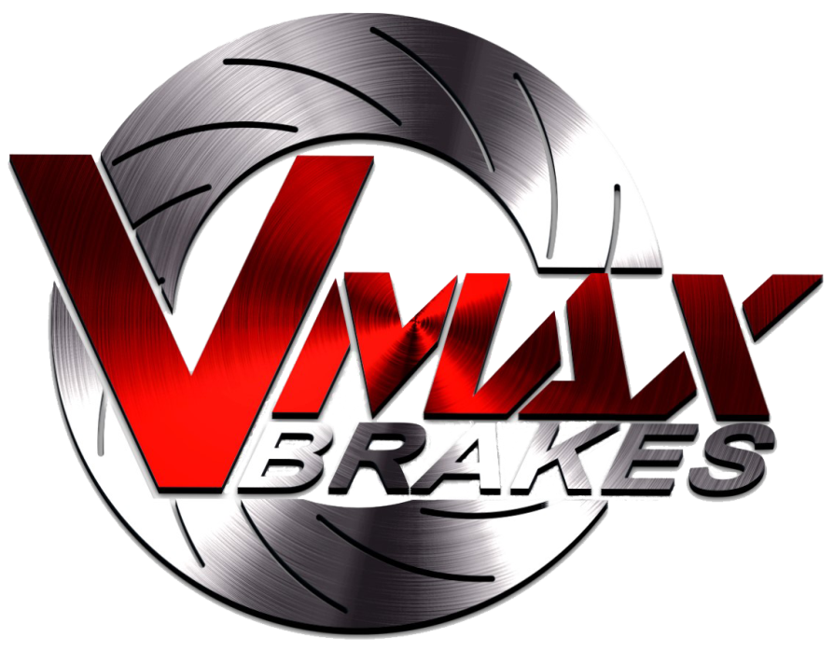
VMAX Brakes is an Australian owned company dedicated to distributing the highest quality aftermarket brake products nationally. Based in the heart of Melbourne, we are passionate about supplying the automotive aftermarket with the highest quality brake products that are manufactured locally. Customer satisfaction is our greatest concern.
Visit our website at www.vmaxbrakes.com.au

Slide 2
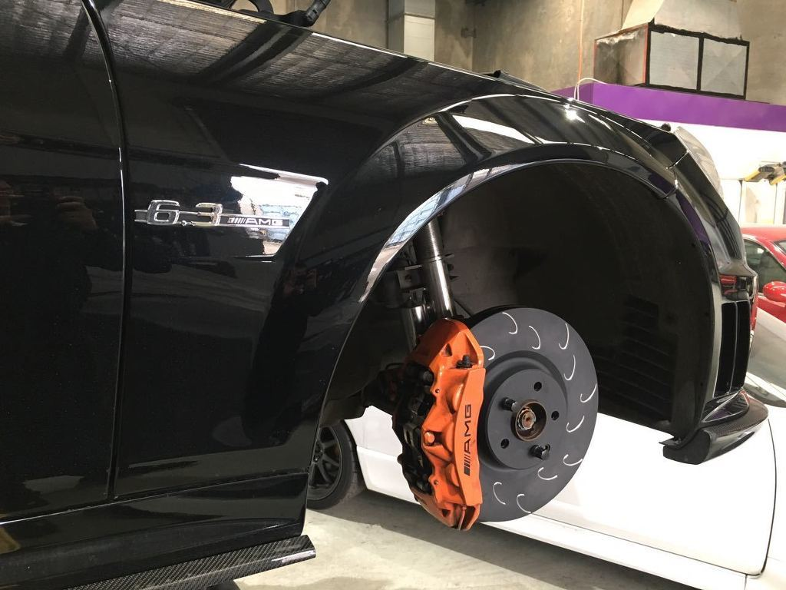
BRAKE ROTORS
Brake disc rotors play an important part in vehicle safety. They stop your car once applied. Here at VMAX Brakes, we specialize in performance brake discs for any make and model. Replace your old items with our new premium products.

Slide 3
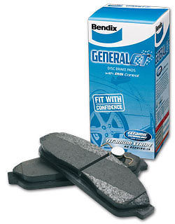
BRAKE PADS
The brake pads also play a key role along with the brake discs when stopping a vehicle. Brake pads are chosen based in the vehicles intended use. We have oem spec pads all the way up to performance and track pads. We cater for all makes and models.

Slide 4
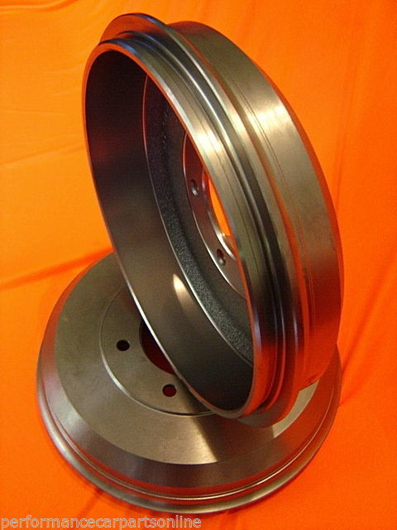
BRAKE DRUMS
Brake drums are an important part of the vehicles safety system. It decelerates the rotation of the wheel when the brakes are applied. Replace your brake drums to upgrade your braking system by shopping for all types of brake drums at Vmaxbrakes.

Slide 5
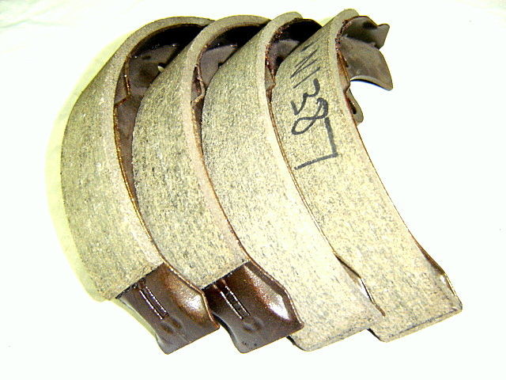
DRUM BRAKE SHOES
At VMAX Brakes we deal in all brake shoes for cars with brake drum systems. We can also supply truck drums and shoes.

Slide 6
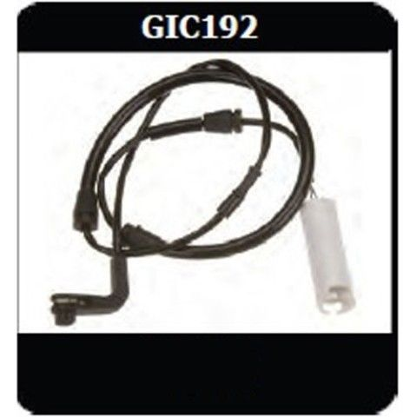
Brake Pad Wear Sensors
Be assured of your safety with brake pad wear sensors. The sensors warn the driver when your brake pads need replacement. When the sensor is triggered a warning light is activated which indicates that your brake pads are in need of change.

Slide 7




CONTACT US
Call us 0404650131
https://www.vmaxbrakes.com.au/
https://www.facebook.com/VMAXBrakes/
https://www.instagram.com/vmaxbrakes/

