Slide 1

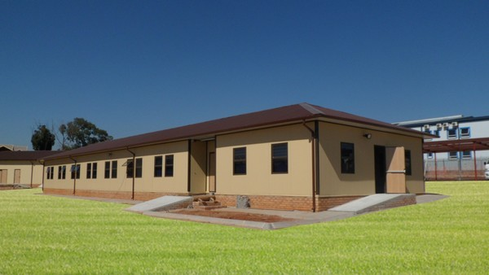
Affordable Prefabricated Houses for Your Residential Usage by Aussie Panel

Slide 2
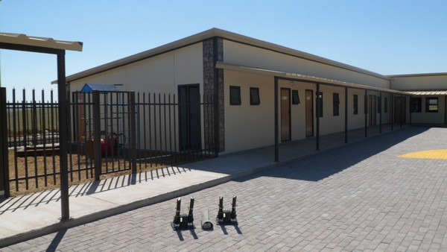
For years prefabricated houses has been garnering wide application rather than commercial constructed homes. Probably the primary reason behind the application is that these types of buildings can be set up at inexpensive prices for your household usage. Therefore cost and functionality are the basic paramount of their acceptance.
Since the decades architects around the world have been observing the economic aspect of prefab homes. There are significant benefits of prefabricated homes which are mentioned below.

Slide 3
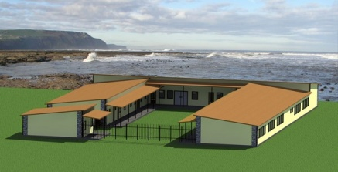
Fast Construction
Unlike custom built homes, it’s quite easy to manufacture prefabricated houses at Aussie Panel. As they are factory made products, so you need to make an order for new homes. Within few weeks of times, our homes are readily available whereas custom built homes takes a longer time period. Now-a-days most of people want to build their dream home quickly; so modular homes are perfect alternative for them.

Slide 4
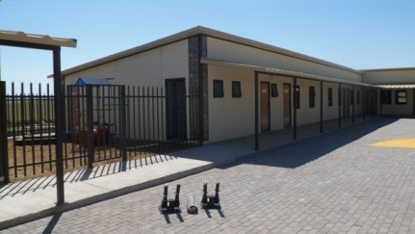
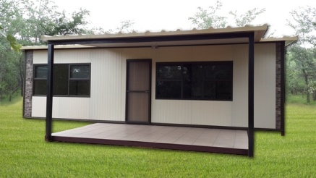
High Quality
As compared to on-site built homes, our prefab homes are fairly insulated and protected as they are manufactured in a climate controlled atmosphere. Also our homes are less affected by natural calamities.
Stronger
Our modular homes need to transport from the factory to the sites for assembling; so they are equipped with high standard durability, design and strength.

Slide 5
Flexible Design
Each of our products can be customized as per the tastes of our individual customers. You will feel free to choose from our wide array of personalized features suiting with individual preference and prospective budget.
Energy Efficient
Manufacturing our prefab homes offers less amount of wastages as the resources can be recycled and reused. They are more often referred as an energy efficient option as these homes are built with extreme care. Also our modular homes need smaller air conditioning and heating units in comparison to ordinary custom built homes.

Slide 6
Contact us:
Aussie Panel
Phone no: +61 (0) 2 63552309
P.O. Box 554,
Lithgow,
New South Wales, 2790, Australia

