Slide 1

Sharpperformance – A Good Service Center for your Luxury Car

Slide 2

Introduction to the Sharp Performance
Sharp Performance is a Melbourne based Car Servicing and Repairing Services providing Company. It is basically situated in South Melbourne. Since 1985, Sharp Performance has been delivering high quality car repairing services to their clients. We believe in maintaining long term relationships with our clients. We are known to have one of the biggest workshops in Australia. European cars are known to be the most expensive and comfortable cars in the whole world. Everybody cannot handle servicing and repairing of these cars. We have a team of experts and hard working people to serve you the best European Car Servicing Services.

Slide 3
Our Specialization
We are specialists in:
We are famous as the European specialists and have the biggest workshop in Australia. We have 27 years of experience in servicing, repairing and maintaining all types of European cars including Audi, BMW, Mercedes Benz, and other luxury cars as well. We make use of all the new and advanced technologies to make it sure that you and your car are getting reliable and trustworthy repairing and maintenance services. We are specialized in:
BMW
Audi
Porsche Land Rover
Volkswagen
Mercedes Benz
Mini Cooper
Sharpperformance
Audi
BMW
Volkswagen
Mercedes Benz

Slide 4
What Services do we offer?
Our team of expert members and highly trained personals offer you high quality repairing and maintenance services. We assure you guaranteed services. The repairing services that we offer not only repair and service your car but they also enhance the efficiency of your royal cars. Our talented and experienced technicians can work on every type of luxury cars.
Services offered by Sharp Performance include:
Timely Servicing for all your European cars
Guaranteed servicing of your Mercedes Benz
Mechanical repairs of all types of European cars including brakes, exhausts, suspension etc.
Testing and Diagnose repairs
Fuel injection servicing
Wheel alignment and balancing
Tire alignments and replacement
Power upgrades

Slide 5
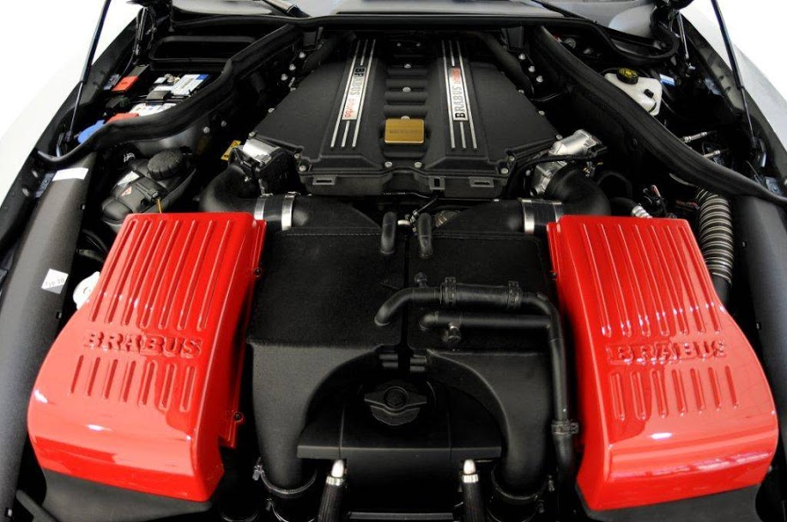
Why one should go for Sharp performance?
Concentrated services
Use of advanced tools and techniques
Guaranteed services
Customer satisfaction
Experienced and expert mechanics
Competitive prices

Slide 6
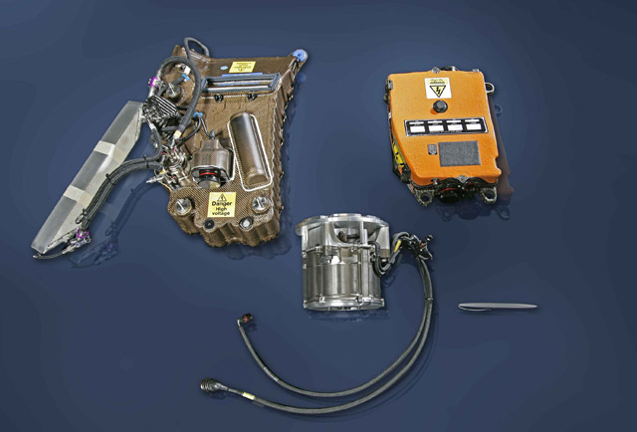
All Needed Requirements & Services
Sharp Performance offers you all types of requirements that are necessary for your European cars. Starting from the very simple job of fuel injection we provide you all the related services like tire alignment, tire replacements and lots more. Experience the actual satisfaction and quality services with Sharp Performance.

Slide 7
Contact Us Now
Sharpperformance
282 Sturt Street. South Melbourne. 3205
Telephone: (03) 9690 0377
Fax: 0396905851
Visit: http://sharpperformance.com.au
Mail: sharp@sharpperformance.com.au

