Slide 1
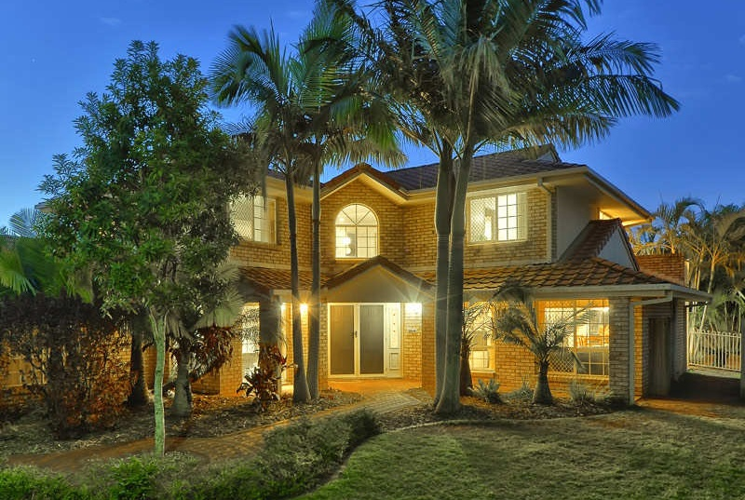
Full House Declutter

Slide 2
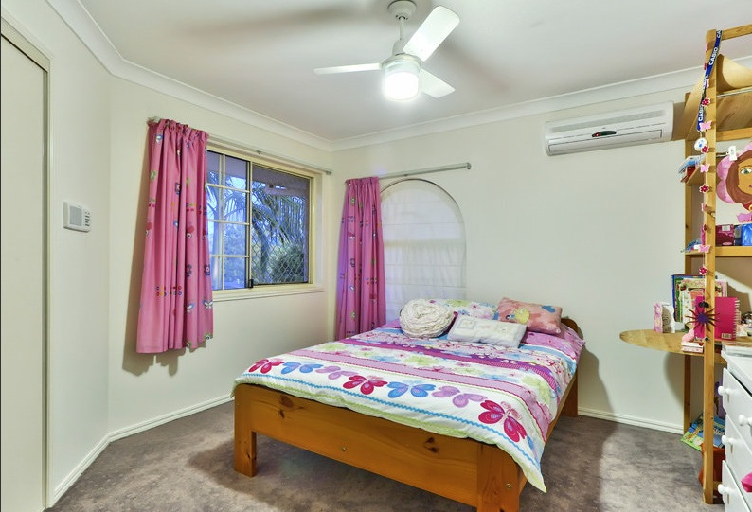
Girls Bedroom after

Slide 3
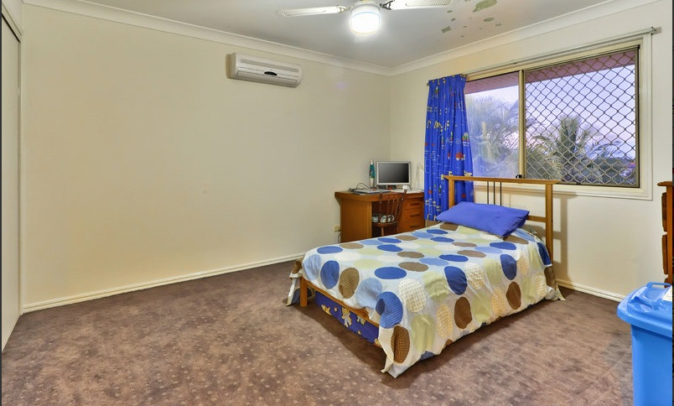
Boys Bedroom 1 after

Slide 4
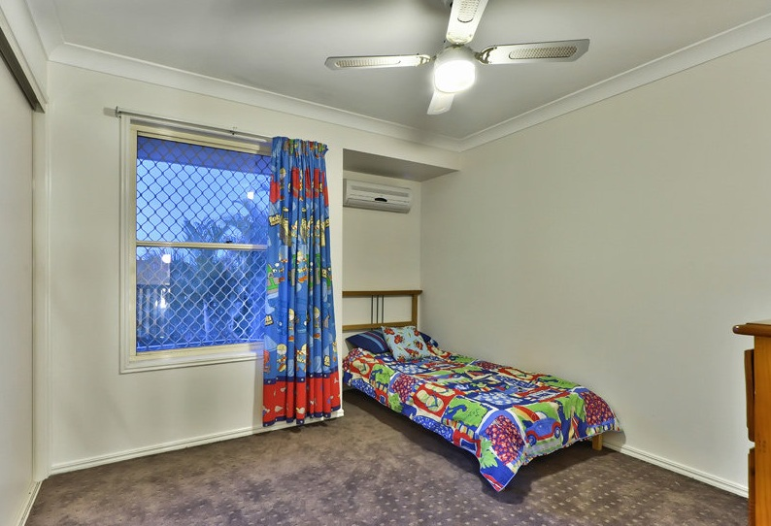
Boys Bedroom 2 after

Slide 5
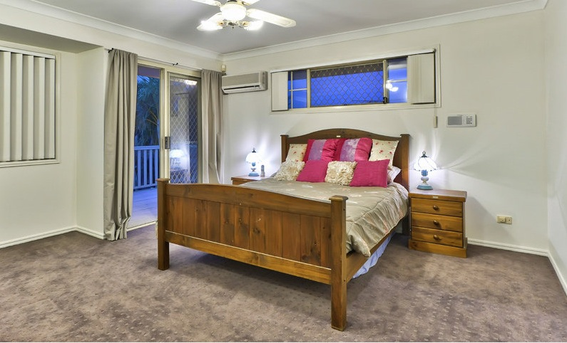
Master Bedroom after

Slide 6
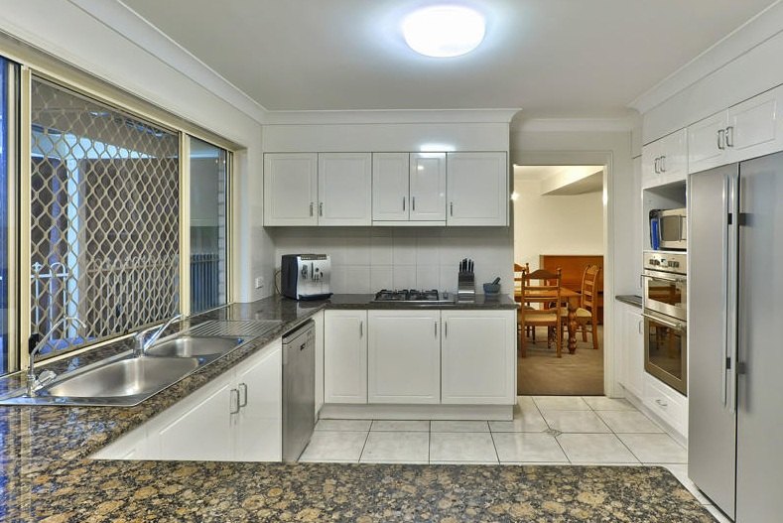
Kitchen after

Slide 7
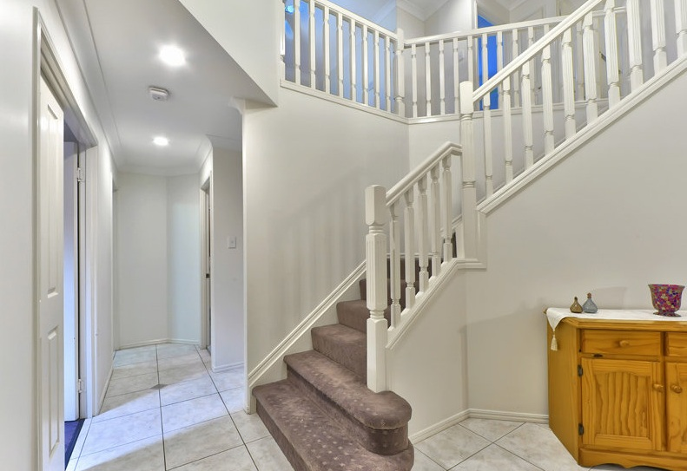
Entry after

Slide 8
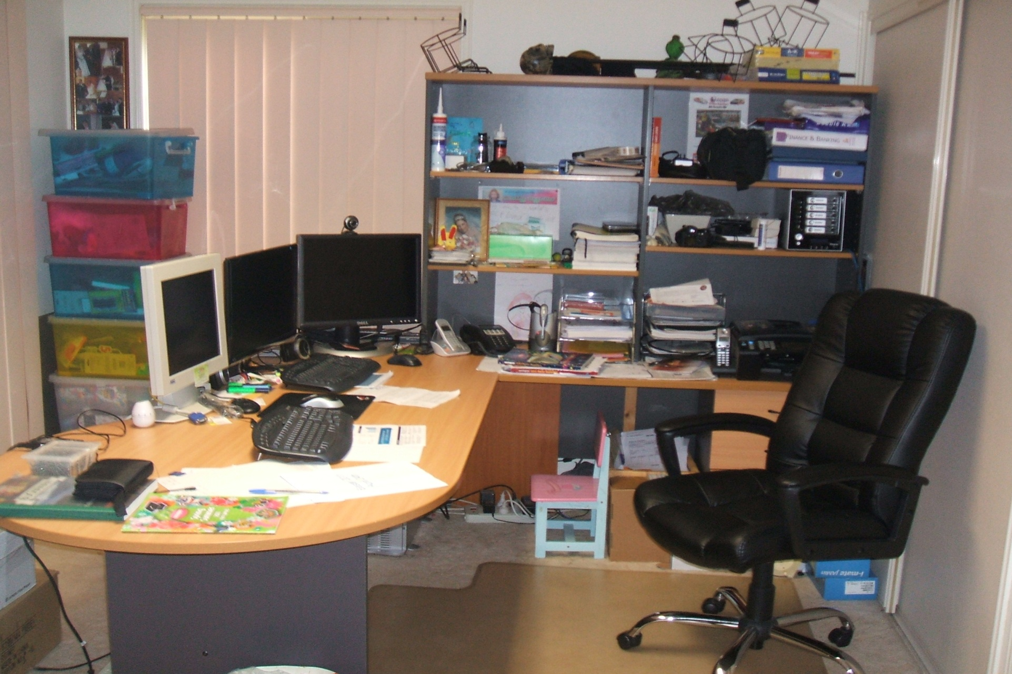
Office before

Slide 9
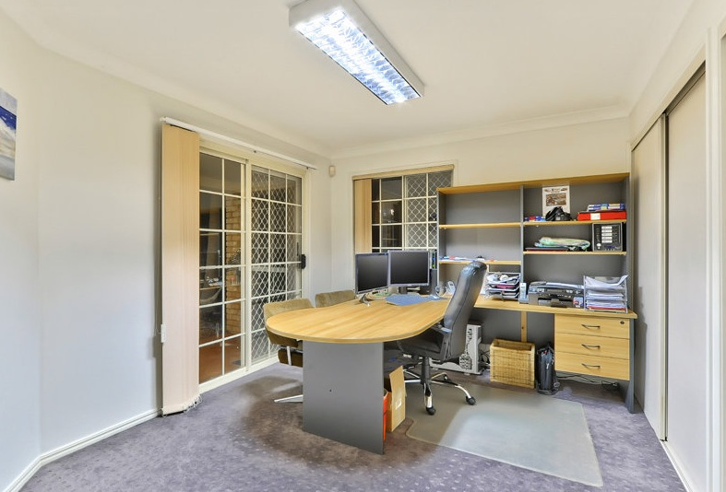
Entry after

Slide 10
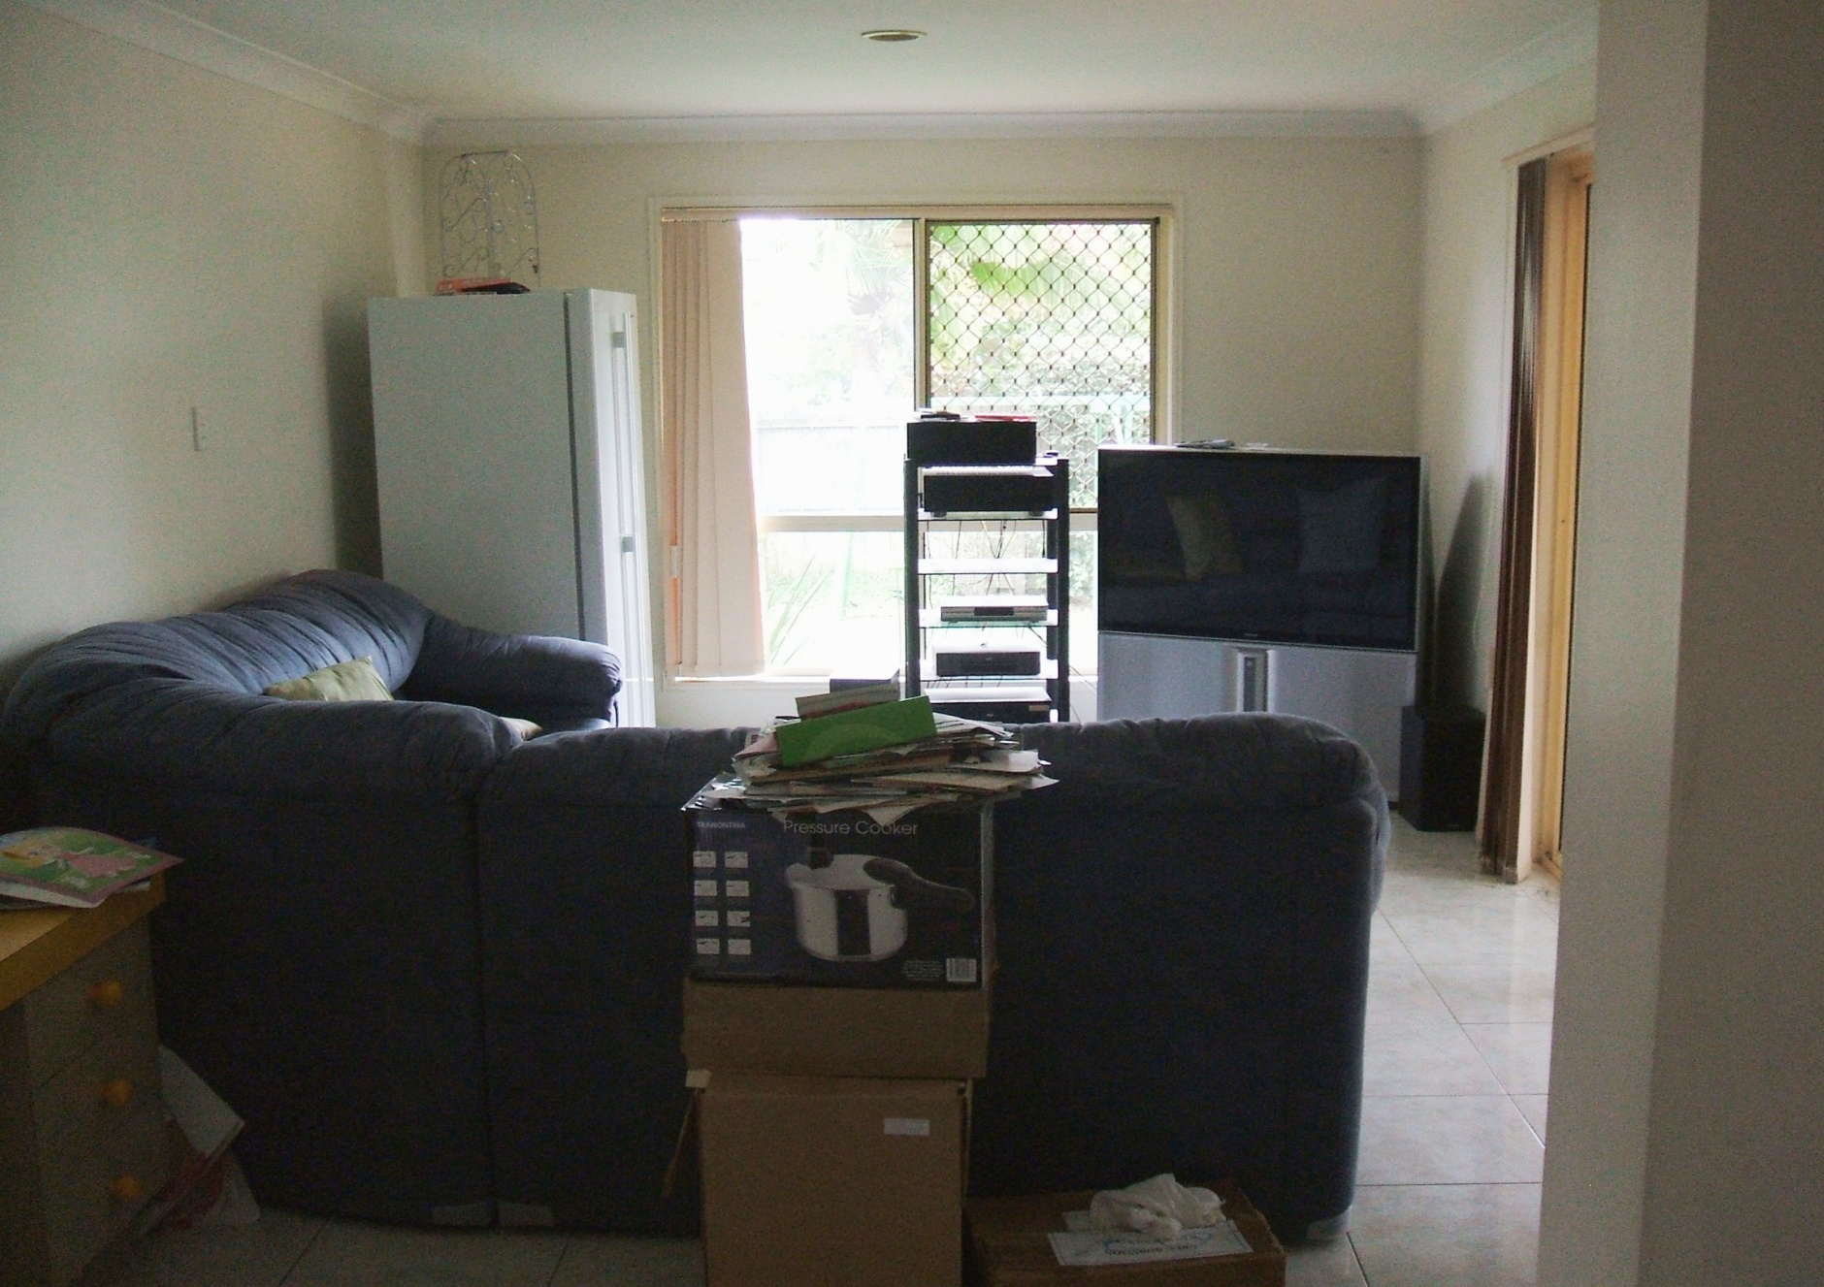
Spare room before

Slide 11
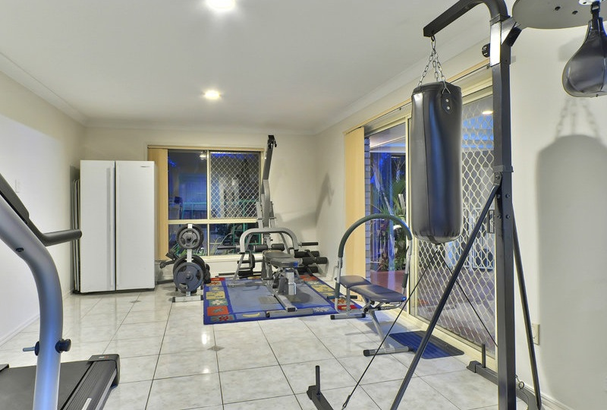
Spare room after

Slide 12
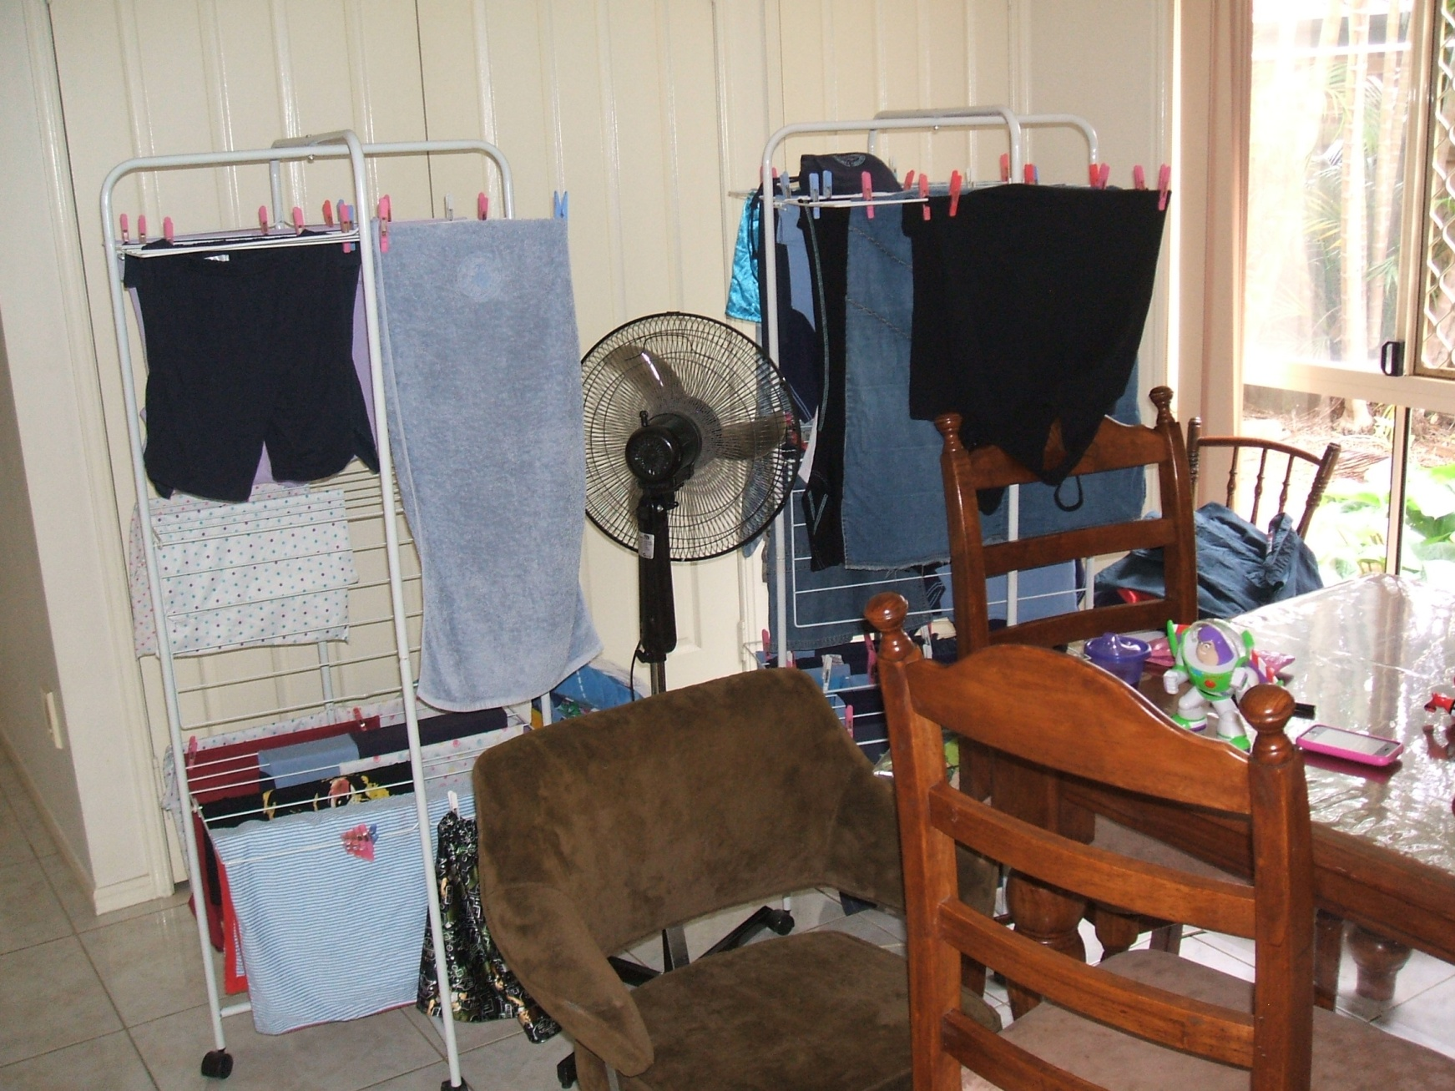
TV/Dining room before

Slide 13
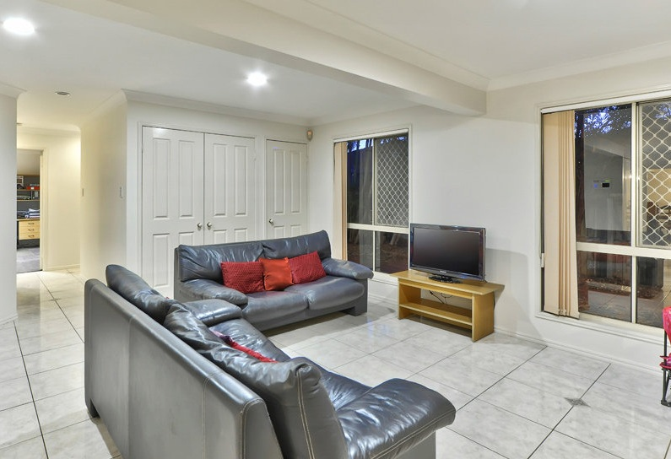
TV room after

Slide 14
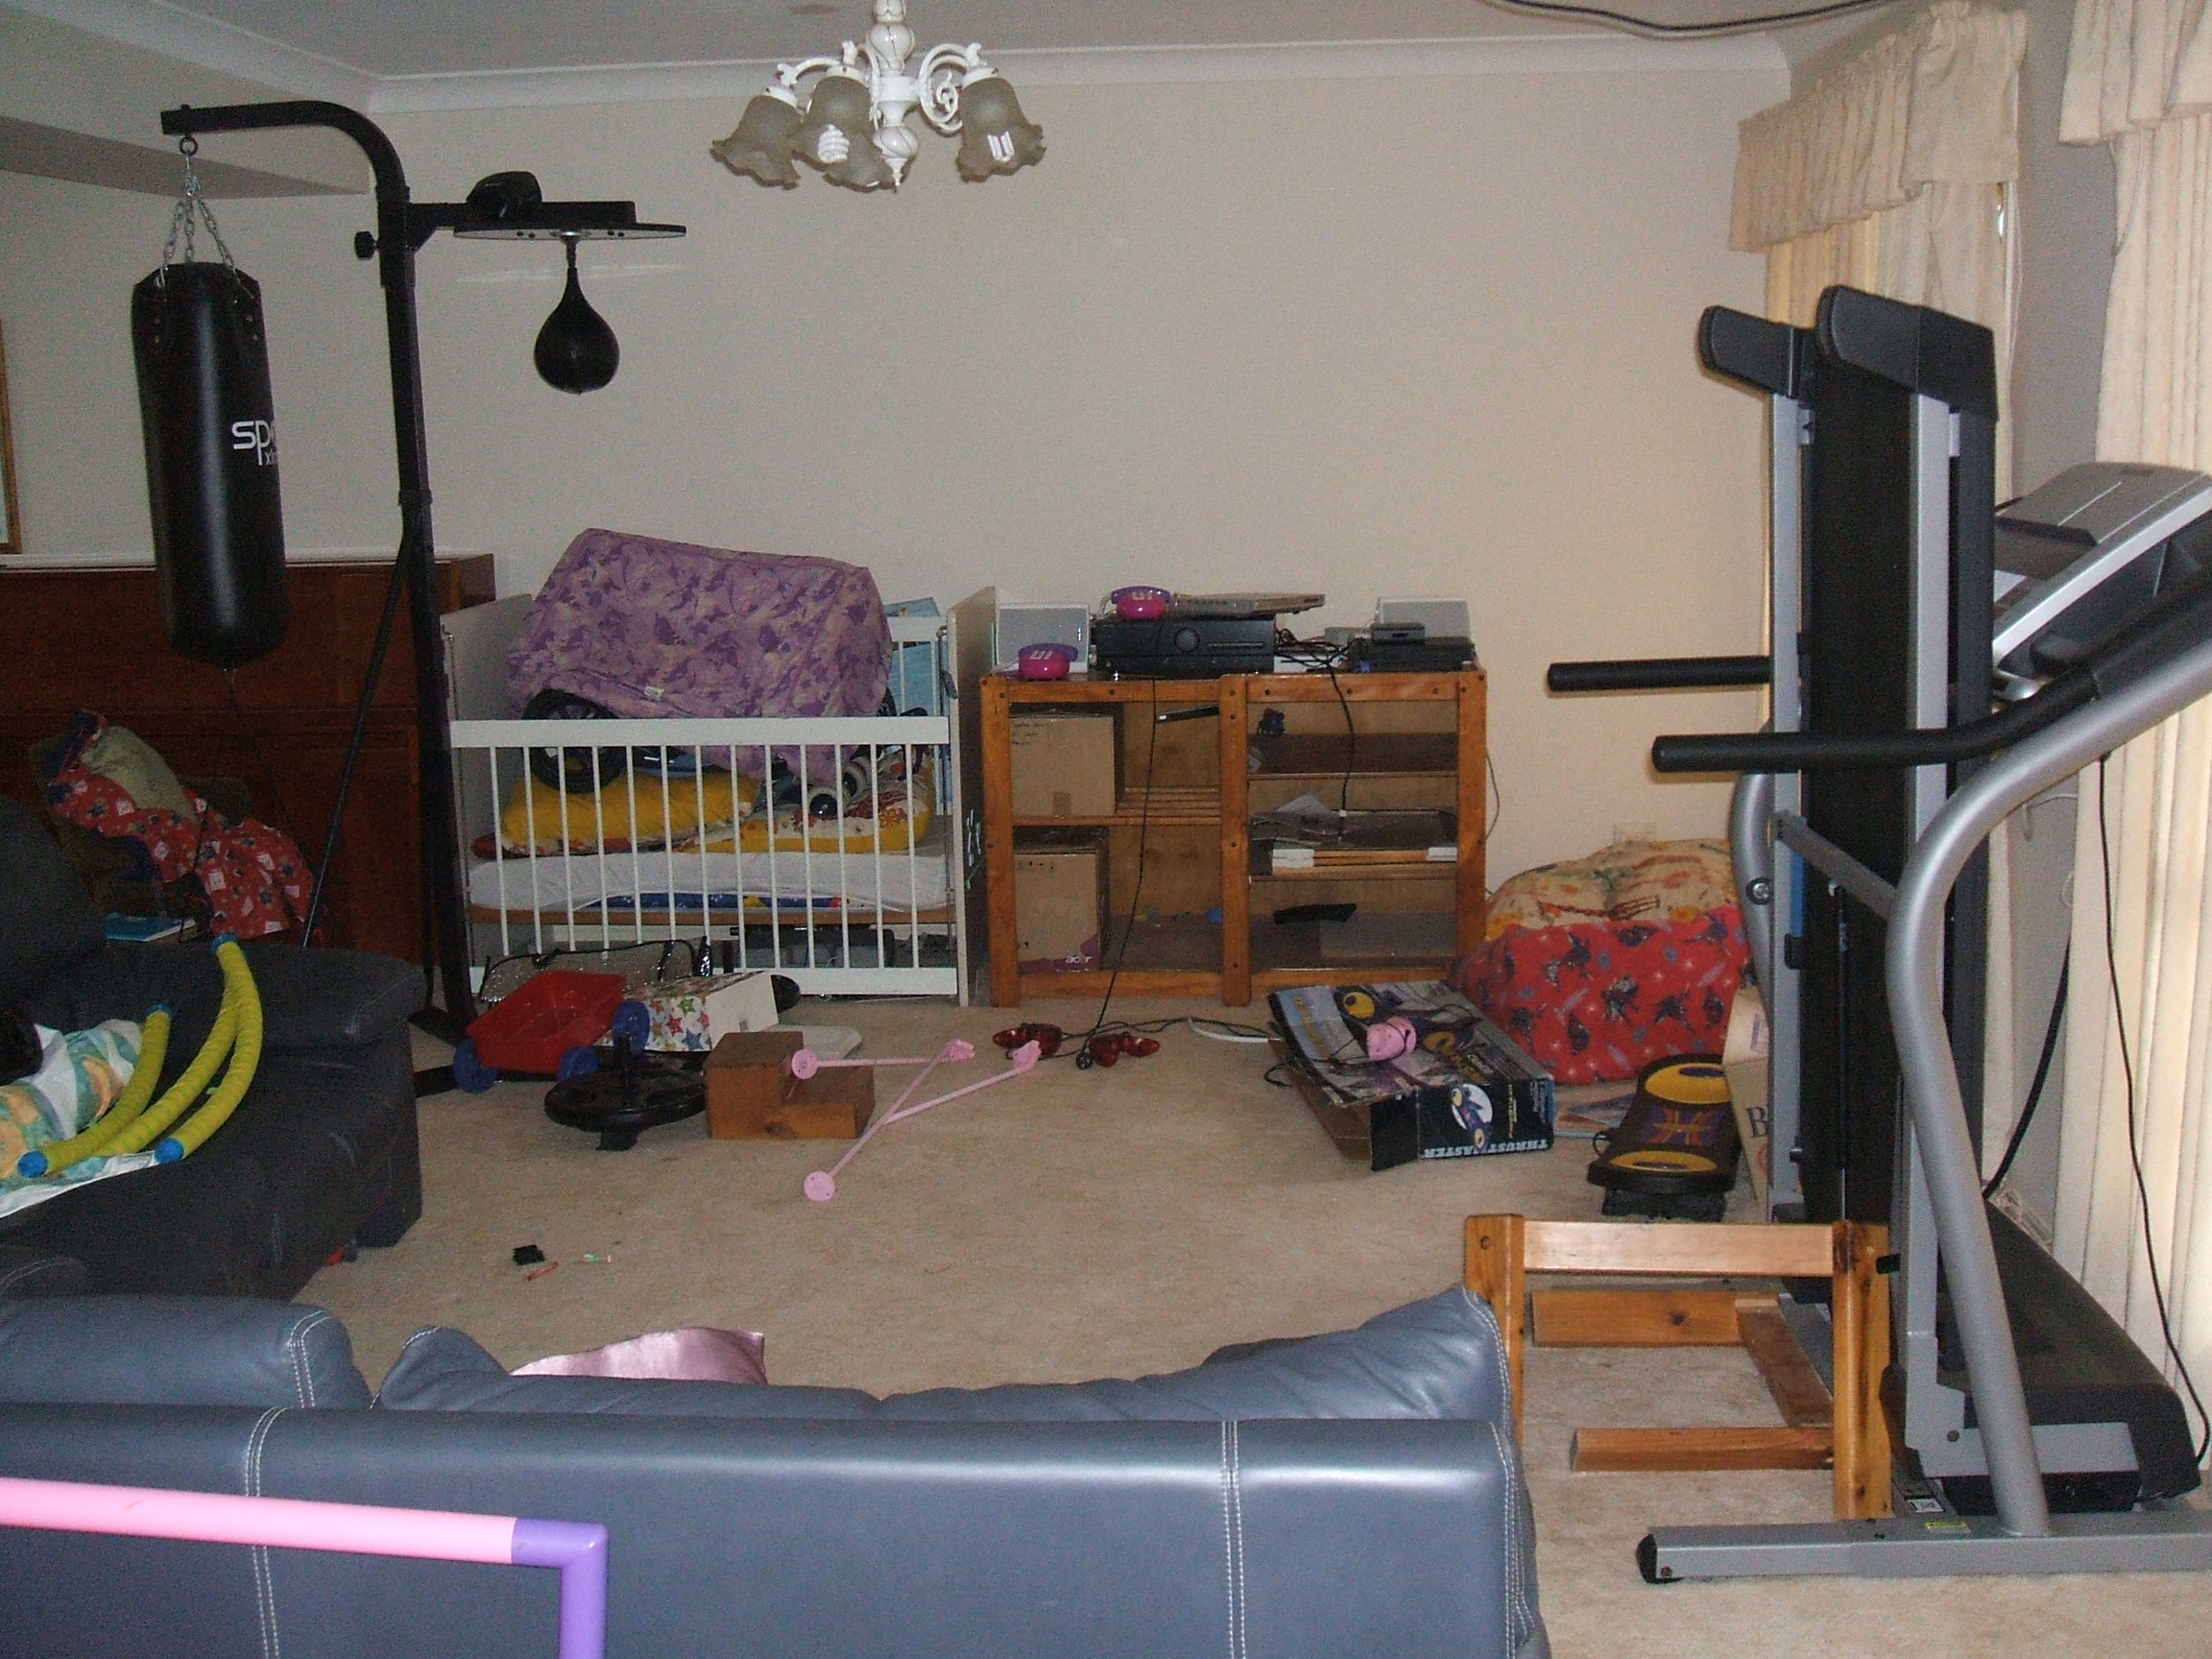
Lounge room before

Slide 15
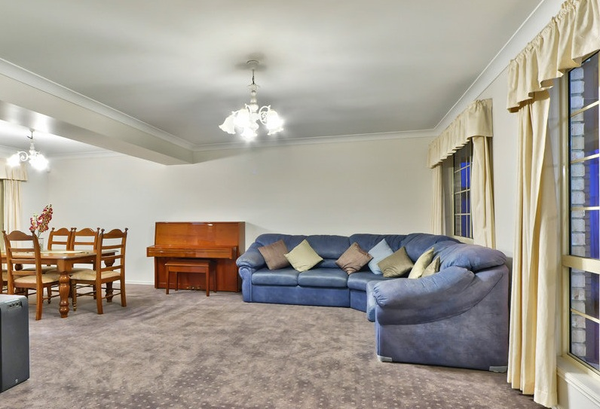
Lounge/Dining room after

Slide 16
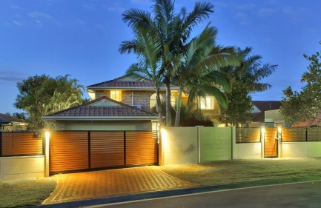
Full House Declutter Testimonial
After the decluttering, organising & complete overhaul was done, we lived in our home for around 6 months until we were ready to sell and move interstate. Donna not only decluttered and organised my things, home goods and lifestyle, but also put systems in place to simplify and maintain the organisation so we could live clutter free.
This declutter was complete, specifically tailored to suit my individual needs and requirements. Now that I have moved interstate and am on my own with organising, it is so much easier to maintain everything and have all systems in place to set up my new home and keep it at a manageable level.

