Slide 1
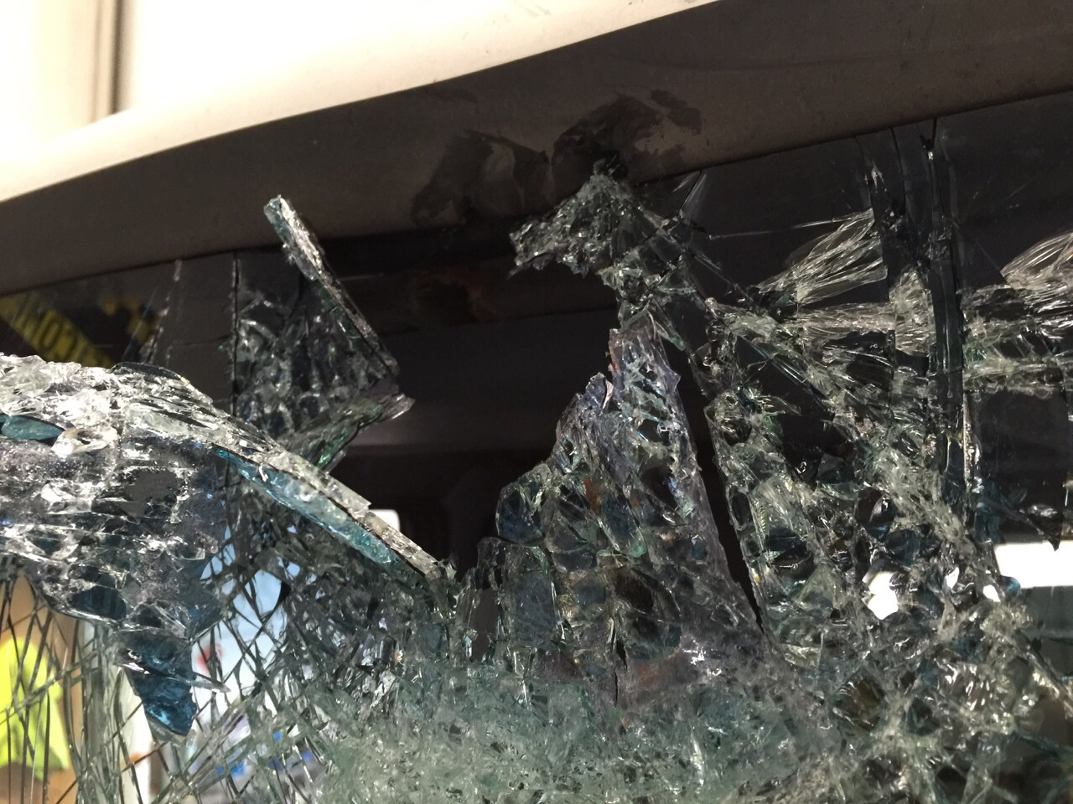




Welcome to A1 Windscreens
The Do’s & Don’ts of Cracked Car Windscreen

Slide 2
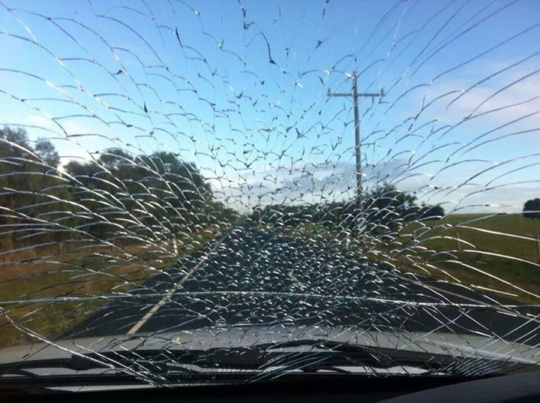
Common Reasons Why Your Windscreen Crack
Often when you drive on a gravelled road or over debris, it can cause the gravel or airborne rocks to spin and hit your windscreen.
Accident is another common reason why your car’s windshield could break. Additionally, poor construction and improper installation of the windscreen can also make it more prone to even the slightest strain.
Understanding what causes your car windscreen to crack can help you avoid the same and prevent windscreen chip and crack repairs over and over again.

Slide 3
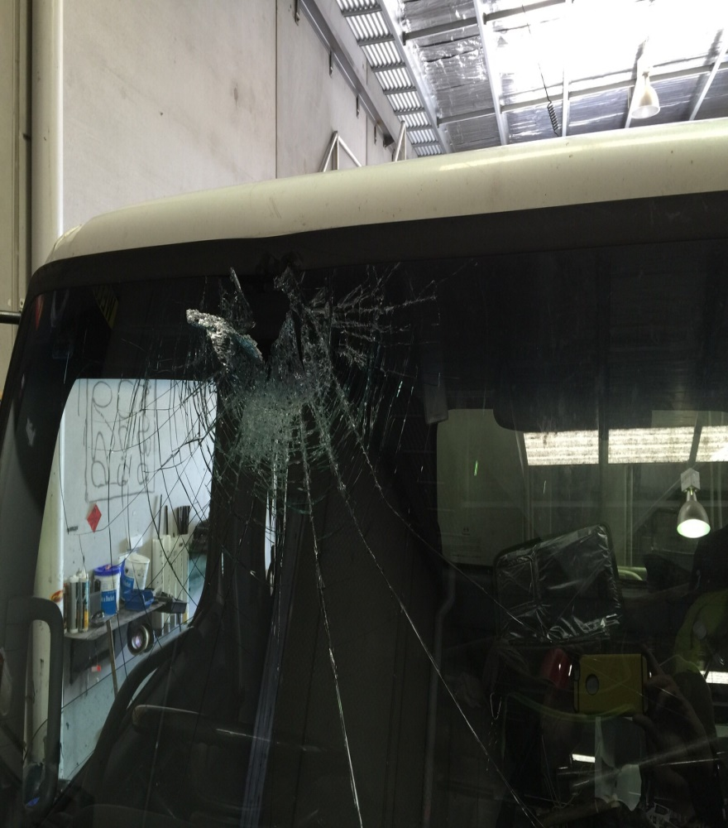
Have a Cracked Windscreen?
Here’s What You Should Do
Here are some tips for you, if you have a cracked or damaged windscreen:
Measure the length of windscreen crack and determine whether it can be repaired or needs to be replaced
Keep the crack protected from dust or dirt as this can make the repair difficult
Keep the car away from direct sunlight as this can weaken the windscreen
If the chip or crack is over the line of sight, get professional services for windscreen chip repair Melbourne

Slide 4
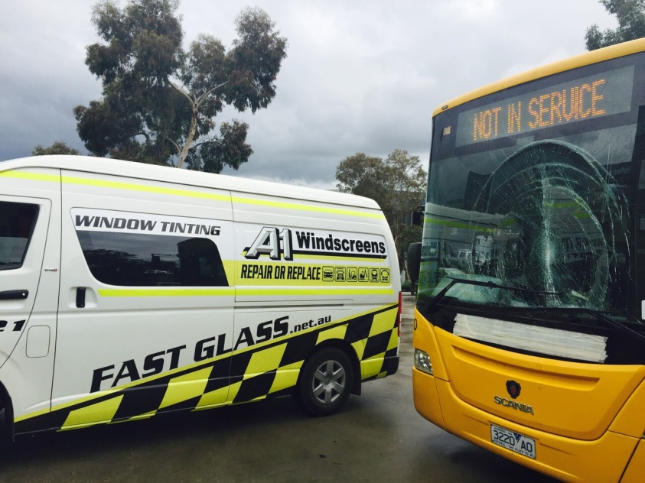

Cracked Car Windscreen
What You Shouldn’t Do?
No matter how big or small the chip or crack is, you shouldn’t do the following –
Do not ignore that you have a cracked windscreen. When left untreated, even a small chip can get worse
Avoid using the air conditioning or defroster on high as this can cause additional pressure on the cracked windscreen
Do not drive on bumpy or off road terrains; make sure that you do not slam doors hard
Do not trust just anybody for car windscreen replacement
To know the do’s and don’ts of a cracked windscreen, call experts at A1 Windscreens today.

Slide 5
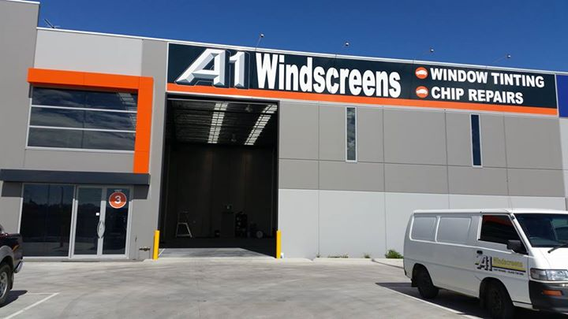
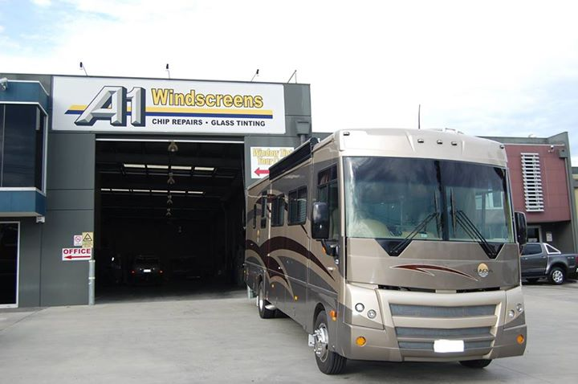

Contact us
A1 Windscreens
  16 Auto Way,
  Pakenham, VIC 3810
  Australia
8:00 am – 4:30 pm
59450333 (Pakenham)
A1 Windscreens
  1/74-80 Melverton Dr
  Hallam, VIC 3803
  Australia
8:00 am – 4:30 pm
87957400 (Hallam)

