Slide 1

3 Mistakes to Watch Out for When Buying a Water Filtration System

Slide 2
WATER TREATMENT SOLUTION
Every home needs an optimal water treatment solution. Unfortunately, not every home owner ends up with the right choice.
A water filtration system is much more than a just a household convenience. It is an inevitable way to ensure the quality and safety of drinking water. While most home owners realise the need for a good water treatment solution, many of them fail to go beyond the cost and design of the system when making the purchase, thus setting their home up for many more expensive water treatment installations in the long-run.

Slide 3

MISTAKES
Failing to realise the right size
Falling for bizarre claims
Counting solely on recomamendations

Slide 4

FAILING TO REALISE THE RIGHT SIZE
It is common for buyers to come across a one-size-fits-all range of water filters and buy one on impulse only to find that the system is too small to accommodate their water filtration needs.
To avoid this mistake, it is necessary to have an approximate estimate of your water flow rate in the first place. This will allow you to find a water treatment system that not only suits your needs but accommodate the flow rates in the long term.

Slide 5
FALLING FOR BIZARRE CLAIMS
By just attaching sophisticated labels and making sham claims about equipment performance, many manufacturers and distributes are able to delude customers into buying run-off-the-mill systems.
If the properties of a system seem too good to be true, you might want to look closely into the equipment and reviews of customers who have used the same equipment before making any decision.

Slide 6

COUNTING SOLELY ON RECOMMENDATIONS
The opinion of a friend or neighbour who has been using a water filtration system for a long time might be of great assistance to you. But know that your water filtration needs might be completely different from that of your neighbours or friends.
What seems like an ideal solution to others might not simply work for your house application. So, be sure to balance your recommendations with vital factors that can help you find a suitable water filter for your home.

Slide 7

ADDITIONAL TIPS
Proper equipment installation requires good plumbing knowledge, tools and practices. Unless you are experienced in the field, leave the job to the professionals.
Consult with a field expert to determine the water filtration needs of your home and know about the best suitable solutions for your application. This will help you make an informed decision and save you time and money in the future.

Slide 8
THE TAKEAWAY
When it comes to water treatment installations, home owners must take the time to consider factors besides brand and cost that may help them drive the most value out of their investment. Avoid these common pitfalls and you can save yourself the trouble, time and money involved in frequent repairs, replacements and new installations.

Slide 9

FINAL WORD
Anyone looking for filter systems in Australia, it is advisable to choose a seller or provider that offers additional services like water analysis, water filter assessment and maintenance and reverse osmosis filter services. This will help you avoid outrageous operational and upkeep costs and save your time.

Slide 10
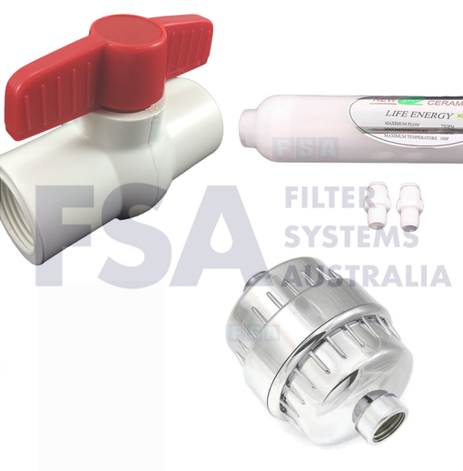
CONTACT US
Filters Systems Australia
https://www.filtersystemsaustralia.com.au
Address: 38 Jade Drive, Molendinar, Gold Coast, QLD 4214
PO Box 4204, Ashmore, Gold Coast, QLD, 4214
Phone: 1300 888 008 or (07) 5597 4585
Email: info@filtersystemsaustralia.com.au

Slide 11
THANK YOU!

