Slide 1
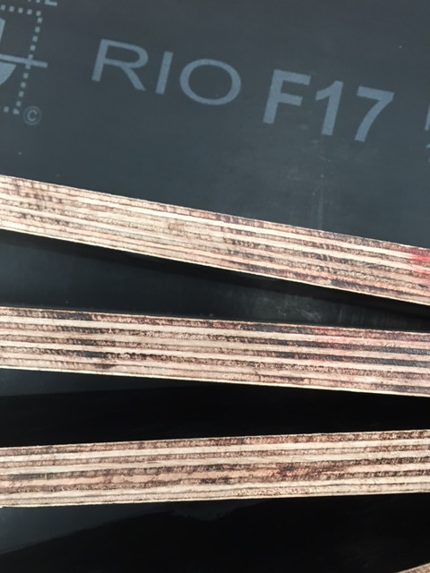
STARGATE BUILDING DEVELOPMENT PTY LTD
ABN : 19607928816
UNIT 2/7 TARLINGTON PLACE, SMITHFIELD, NSW 2164 TEL: 0415384799
Industry F17 Structural Plywood
1800 x 1200 x 17mm
Benchmark Certificate No: BMP 613113
We are importer for Formwork Structural Plywood from China, we believe quality products make long term business.
RING US FOR BEST PRICE TODAY.

