Slide 1



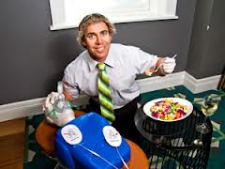

EFI Training Pty Ltd
Eastern Suburb’s First Aid Training Specialists.
APPLy FIRST AID
Course unit number: HLTFA311A
Nationally Accredited One Day Training Courses
Apply First Aid – Perform CPR – Child Care Asthma & Anaphylaxis – Provide Emergency Care
Monday’s
381 Clovelly Road, Clovelly
Saturday’s
50-52 Frenchman’s Road Randwick
$145 per person includes a full menu lunch with refreshments
In partnership and under the Auspices of Allen’s Training Pty Ltd RTO number 90909.
CALL US TODAY! Bookings are essential.
Contact Eden Findley on 0407 957 907 or email bodyburner@bigpond.com
EFI TRAINING Pty Ltd - ABN 20 156 500 328

